Slide 1
Maths Week England Quiz
Higher Tier GCSE

Slide 2
Information for teachers
You can use this quiz at any time of year, but what better way to celebrate Maths Week England!
This quiz is aimed at students who are studying for the higher tier at GCSE. Questions have reasoning and problem-solving aspects rather than being just calculations.
The quiz has 10 questions, with the answers following a warning slide at the end of questions. You may want to miss out some questions depending on the content that your students have covered. Questions are numbered to make marking easier; if you want miss out some of our questions, you may want to replace them or tell your students that not all questions are being asked.
We envisage that this is a team quiz where teams swap answer sheets to mark the quiz, but you can organise this as you see fit in your classroom.
All questions can be answered on plain paper, though you may want to provide separate paper for students to separate their answers from their working.
Please think about saving time for going over any answers as needed.
We have not provided prizes as we think doing maths in a fun way is enough!

Slide 3
1 How much money is raised?
To raise money, people are asked to guess the weight of a cake. It costs £1 per go.
Prizes are:
£10 for the closest weight
£5 for next closest cake
£1 for the third closest weight
50 people take part; how much money is raised after the prizes are awarded?

Slide 4
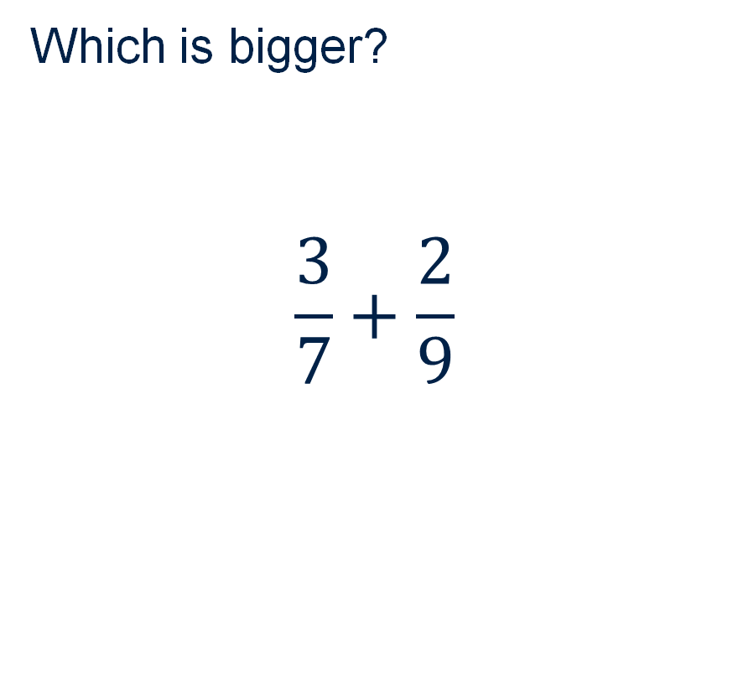
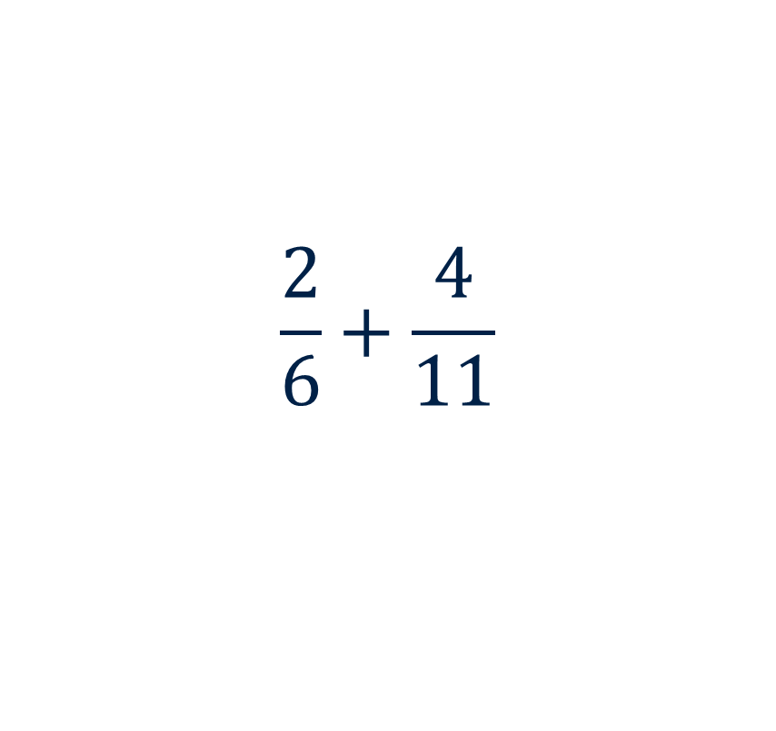
2 Comparing fractions
Which is bigger?
$$\frac{3}{7}+\frac{2}{9}$$
$$\frac{2}{6}+\frac{4}{11}$$

Slide 5
3 Can you make…
Rosie has bags of 1p, 2p and 5p coins.
Can she use exactly 8 coins to make 30p?

Slide 6
4 Best buy
Sam needs 4 bottles of lemonade. There are two offers, which is best?
Offer 1
3 for 2 on bottles of lemonade.
Offer 2
20% off all bottles of lemonade

Slide 7


5 Area
What is the area of the shaded part?
Not drawn to scale
$$8 {cm}^{2}$$
$$5 cm$$

Slide 8
6 Flooring
Toby wants to cover the floor of his kitchen in tiles.
The ones he likes are 333 mm by 333 mm and need approximately 1 mm grouting between each tile.
He measures his kitchen as 3 m by 4 m.
How many tiles will he need?

Slide 9
7 How many nines?
A book has 129 numbered pages. How many times is the digit 9 used in the page numbering?

Slide 10
8 Biggest area?
Mark has 24 matchsticks, all the same length. If he arranges them as a rectangle, what’s the biggest area he can enclose?

Slide 11
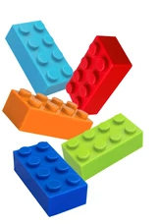
9 Arranging bricks
Peni has five toy building bricks.
She needs to stack two for a model.
How many different ways can she choose two bricks?
(Choosing red then orange is not the same as choosing orange then red.)
Notes:
Image: https://www.shutterstock.com/search/lego-bricks

Slide 12
10 How many paving slabs?
Alex wants to make a path out of paving slabs. The path should be between 50cm and 1m wide and needs to be 10m long.
He finds some paving slabs which measure 400mm by 400mm.
How many slabs will he need?

Slide 13
Warning!
Answers on next slides

Slide 14
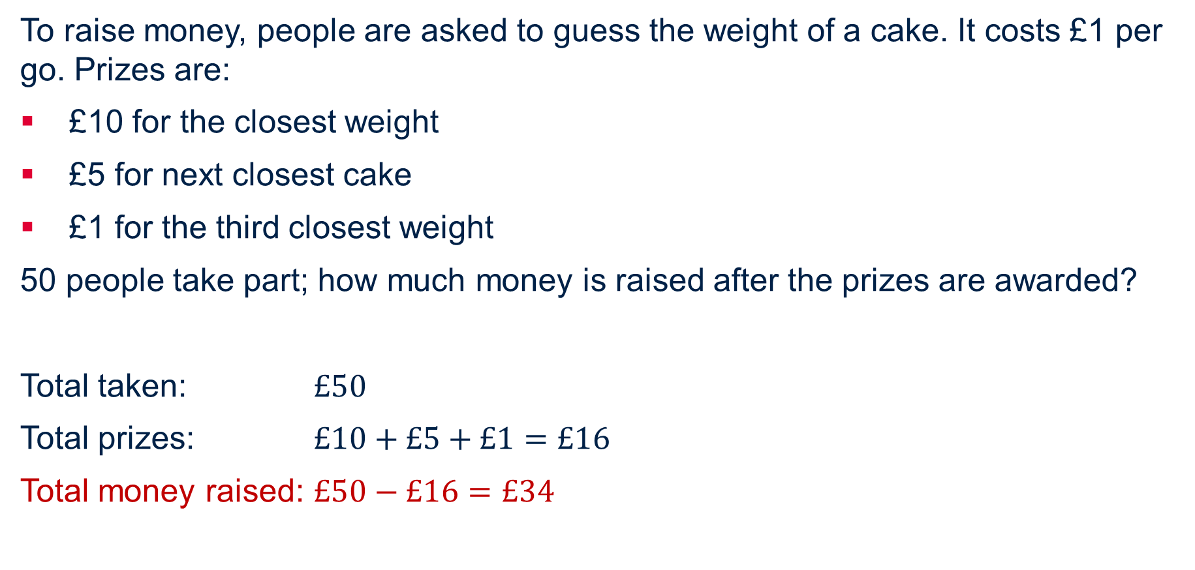
1 How much money is raised? Answer
To raise money, people are asked to guess the weight of a cake. It costs £1 per go. Prizes are:
£10 for the closest weight
£5 for next closest cake
£1 for the third closest weight
50 people take part; how much money is raised after the prizes are awarded?
Total taken: $£50$
Total prizes: $£10+£5+£1=£16$
Total money raised: $£50−£16=£34$

Slide 15
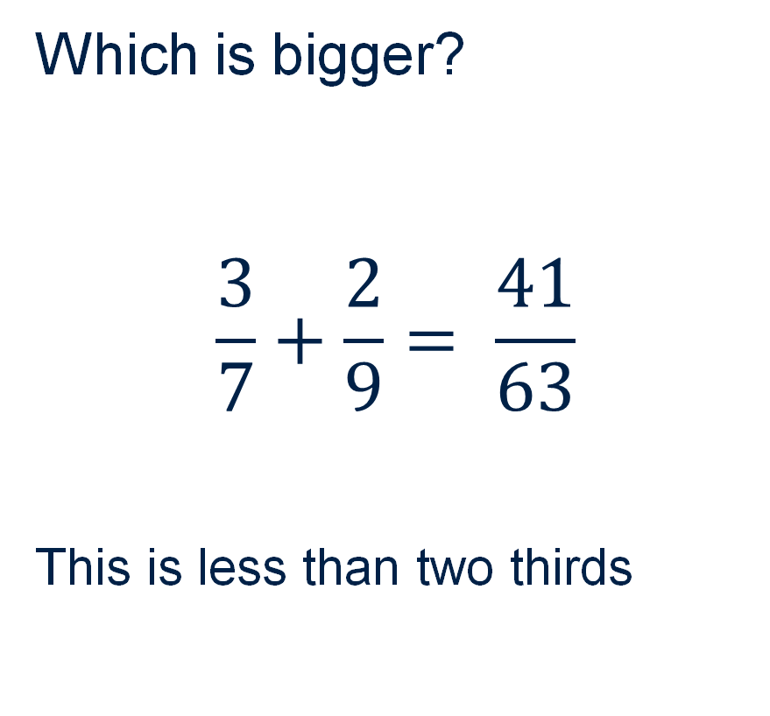
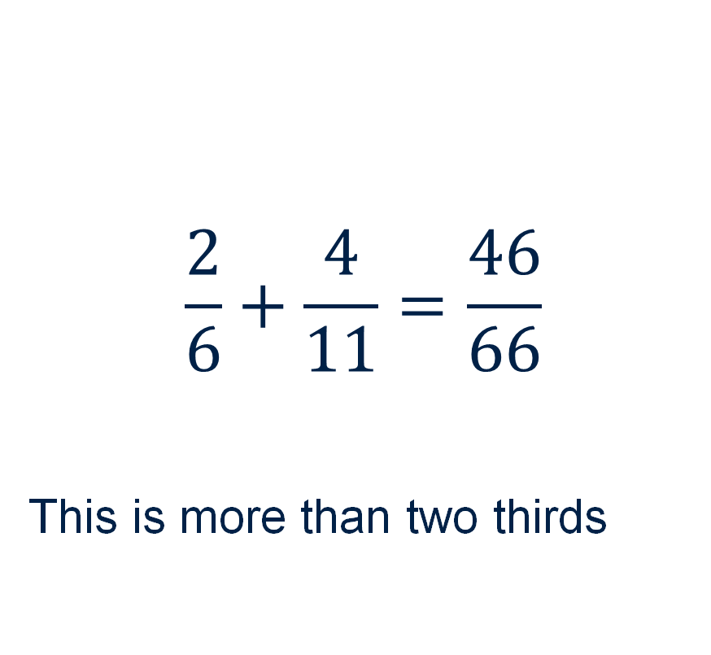
2 Comparing fractions - Answer
Which is bigger?
$$\frac{3}{7}+\frac{2}{9}= \frac{41}{63}$$
This is less than two thirds
$$\frac{2}{6}+\frac{4}{11}=\frac{46}{66}$$
This is more than two thirds

Slide 16
3 Can you make… Answer
Rosie has bags of 1p, 2p and 5p coins.
Can she use exactly 8 coins to make 30p?
One way is: 5p, 5p, 5p, 5p, 5p, 2p, 2p, 1p
Are there other ways?

Slide 17
4 Best buy - Answer
Sam needs 4 bottles of lemonade. There are two offers, which is best? Start by assigning an ‘easy’ amount such as £1 per bottle.
Offer 1 is the best buy for 4 bottles of lemonade
Offer 1
3 for 2 on bottles of lemonade.
4 bottles would be
3 for £2 (using the offer) + £1
=£3
Offer 2
20% off all bottles of lemonade
4 bottles would be
£4 x 80%
=£3.20

Slide 18


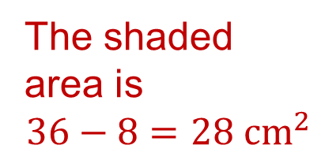
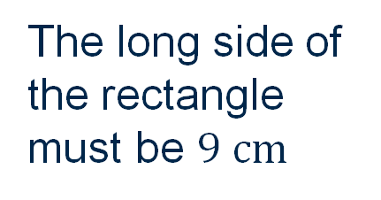
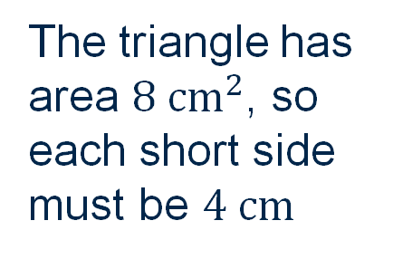
5 Area - Answer
What is the area of the shaded part?
One solution – is yours the same?
Not drawn to scale
The triangle has area $8 {cm}^{2}$, so each short side must be $4 cm$
The area of the rectangle is 36 cm²
$$8 {cm}^{2}$$
The long side of the rectangle must be $9 cm$
The shaded area is
$$36−8=28 {cm}^{2}$$
$$5 cm$$

Slide 19
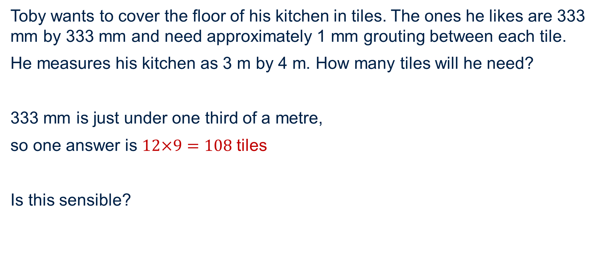
6 Flooring - Answer
Toby wants to cover the floor of his kitchen in tiles. The ones he likes are 333 mm by 333 mm and need approximately 1 mm grouting between each tile.
He measures his kitchen as 3 m by 4 m. How many tiles will he need?
333 mm is just under one third of a metre,
so one answer is $12×9=108$ tiles
Is this sensible?
Notes:
Students may disagree with this, but the grouting will be more than take up the gap.

Slide 20
7 How many nines? Answer
A book has 129 numbered pages. How many times is the digit 9 used in the page numbering?
double digit
One as a unit for each of the groups of ten (9)
One for the initial digit in the nineties (10)
So 19 times
triple digit
One as a unit for each of the groups of ten up to 29
So 3 times
single digit
Just the digit 9
So 1 time
Total is 23 times as a page number

Slide 21
8 Biggest area? Answer
Mark has 24 matchsticks, all the same length. If he arranges them as a rectangle, what’s the biggest area he can enclose?
We can find these rectangles:
11 x 1 area is 11
10 x 2 area is 20
9 x 3 area is 27
8 x 4 area is 32
7 x 5 area is 35
6 x 6 area is 36
this is the biggest area

Slide 22
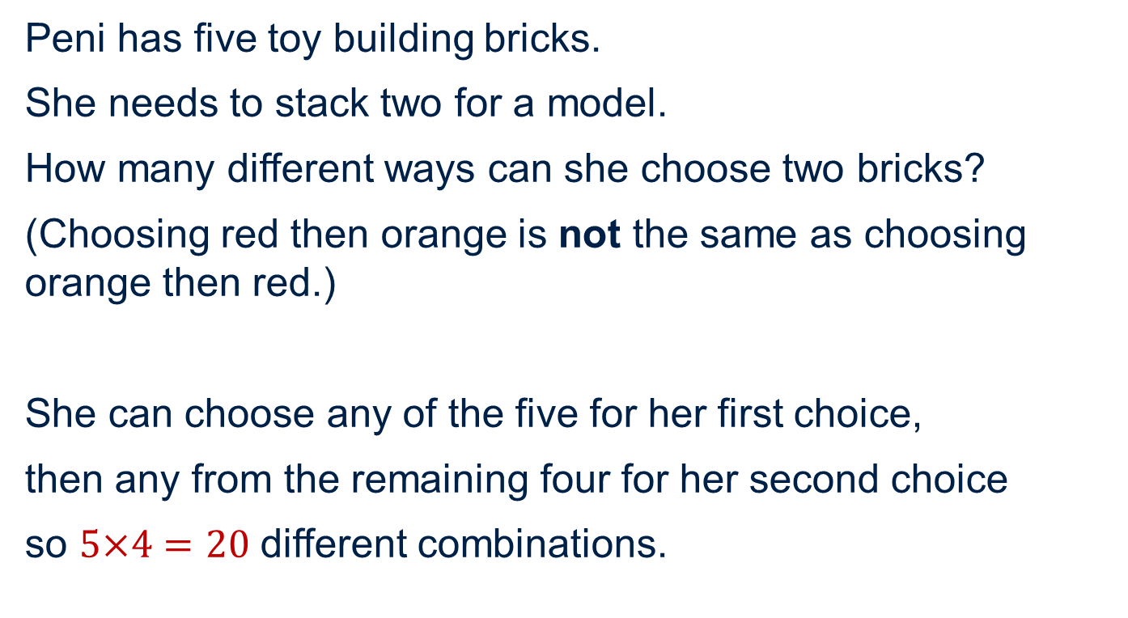
9 Arranging bricks - Answer
Peni has five toy building bricks.
She needs to stack two for a model.
How many different ways can she choose two bricks?
(Choosing red then orange is not the same as choosing orange then red.)
She can choose any of the five for her first choice,
then any from the remaining four for her second choice
so $5×4=20$ different combinations.
Notes:
Image: https://www.shutterstock.com/search/lego-bricks

Slide 23
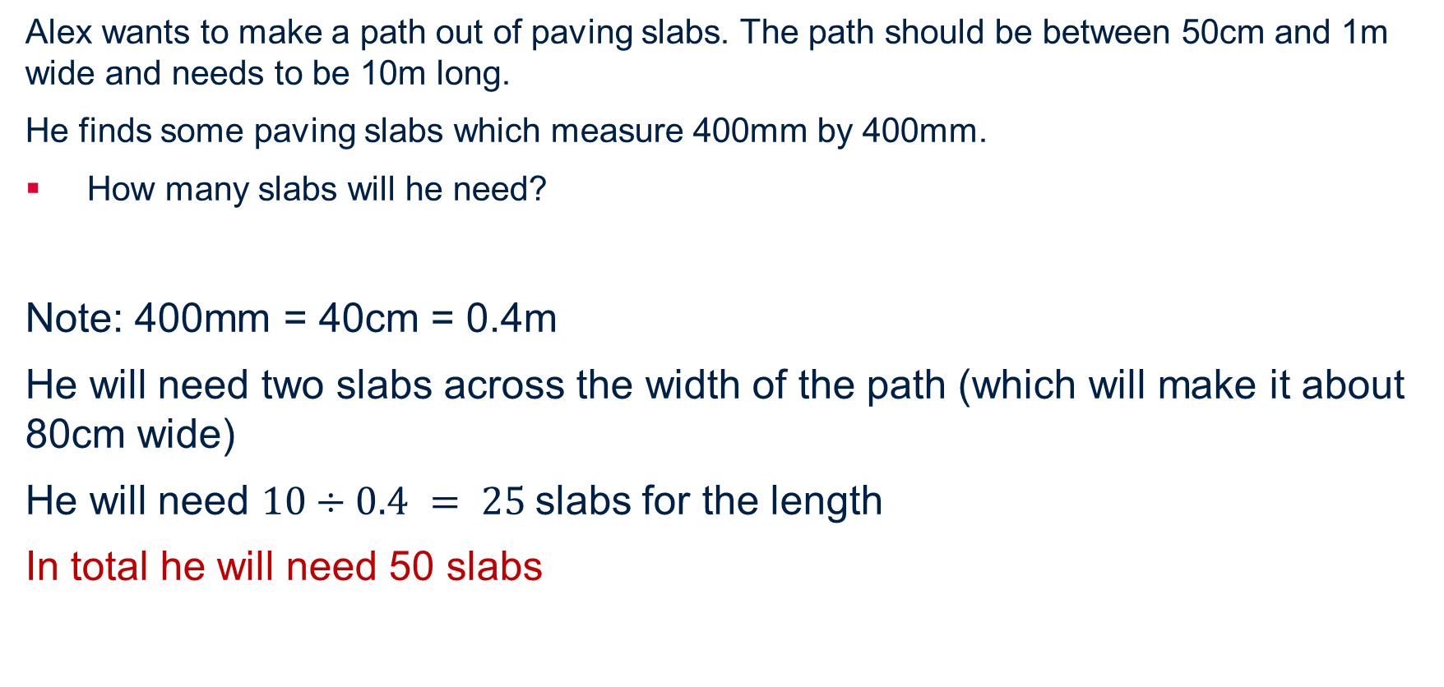
10 How many paving slabs? Answer
Alex wants to make a path out of paving slabs. The path should be between 50cm and 1m wide and needs to be 10m long.
He finds some paving slabs which measure 400mm by 400mm.
How many slabs will he need?
Note: 400mm = 40cm = 0.4m
He will need two slabs across the width of the path (which will make it about 80cm wide)
He will need $10÷0.4 = 25$slabs for the length
In total he will need 50 slabs

