Slide 1
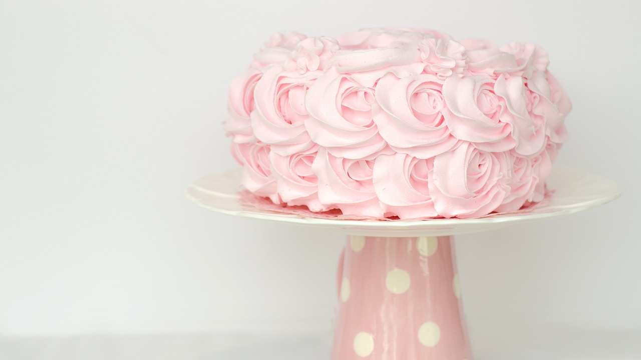
It is Anna’s birthday!
Can you help her to cut
her birthday cake into 8
equal pieces?
You can only make 3 cuts.
Have a go!

Slide 2
Solution
2nd cut
3rd cut
1st cut
Click to see each of the cuts

Slide 3
About MEI
Registered charity committed to improving mathematics education
Independent UK curriculum development body
We offer continuing professional development courses, provide specialist tuition for students and work with employers to enhance mathematical skills in the workplace
We also pioneer the development of innovative teaching and learning resources

