Slide 1
Where’s the maths in that?
Notes:
This is an optional slide to get students into the situation of the problem? What can they see in the picture? What do they notice? What do they wonder? Can they think about where any maths might be used?
Photo by Marcin Jozwiak on Unsplash

Slide 2
Lorry Loading
Algorithms are used to pack the lorries as efficiently as possible
This delivery company load items straight into the lorries.
Your job is to investigate the efficiency of two lorry loading algorithms.
Notes:
An algorithm is a process or set of rules to be followed in calculations or other problem-solving operations
Photo by Marcin Jozwiak on Unsplash

Slide 3
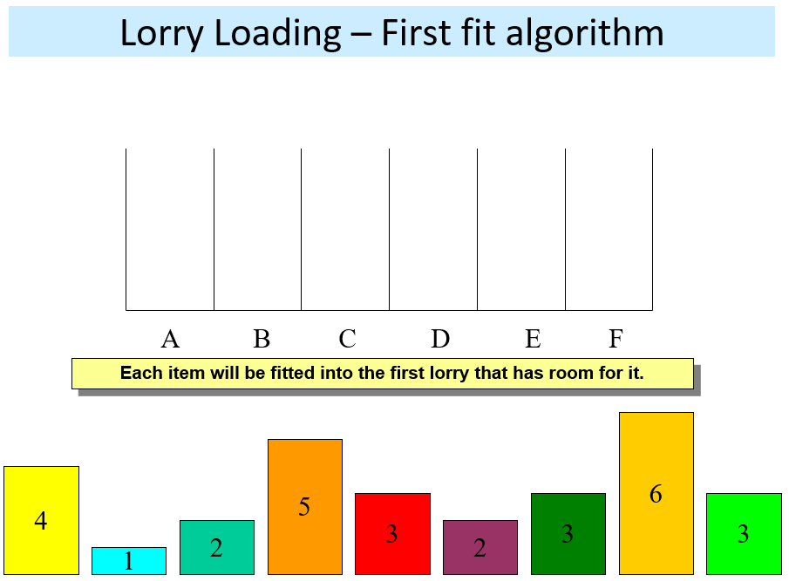
The “First Fit” Algorithm
Each lorry (A-F) has a capacity of 6.
Starting with the first object (on the left), fit each object into the first lorry that has room for it.
How many Lorries are needed?
Hint: make your own diagram and use pencil to draw the items inside the lorries. The first item has been done for you.
4

Slide 4
The “First Fit Decreasing” Algorithm
Each lorry has a capacity of 6.
Starting with the largest object (and then the second largest etc), fit each object into the first lorry that has room for it.
How many Lorries are needed?
Hint: Remember to start with the biggest item and work your way down.

Slide 5
What do you think?
1. Which algorithm was the most efficient for loading the lorries?
2. What advice would this lead you to giving the company when loading their lorries?
3. What are the limitations of this model for this purpose?
4. Does this change the advice you would give?
Notes:
Edit these questions as appropriate.
It is not just lorries that are loaded, could be aeroplanes, ships etc.. A relevant job you could explore is Loadmaster. What might the consequences be of incorrectly loading a plane for example?
Not always possible to use first fit decreasing algorithm as all ‘packages’ would need to be sorted first. If this was cars arriving to go on a Ferry or suitcases arriving for a flight then it would be very difficult or time consuming to do.

Slide 6
Solution

Slide 7
Solution
Step 1

Slide 8
Solution
Notes:
More interesting algorithms in this Marcus du Sautoy documentary:
The Secret rules of modern living- Algorithms. https://www.youtube.com/watch?v=kiFfp-HAu64
Watch from 23:40 to 32:17 to find out more about Anna’s favourite algorithm -
Gale Shapley Algorithm (Stable Marriage problem) explained really simply and also how it has important applications (e.g. in matching organ donors to recipients) in this Marcus du Sautoy documentary:

Slide 9
About MEI
Registered charity committed to improving mathematics education
Independent UK curriculum development body
We offer continuing professional development courses, provide specialist tuition for students and work with employers to enhance mathematical skills in the workplace
We also pioneer the development of innovative teaching and learning resources

