Slide 1
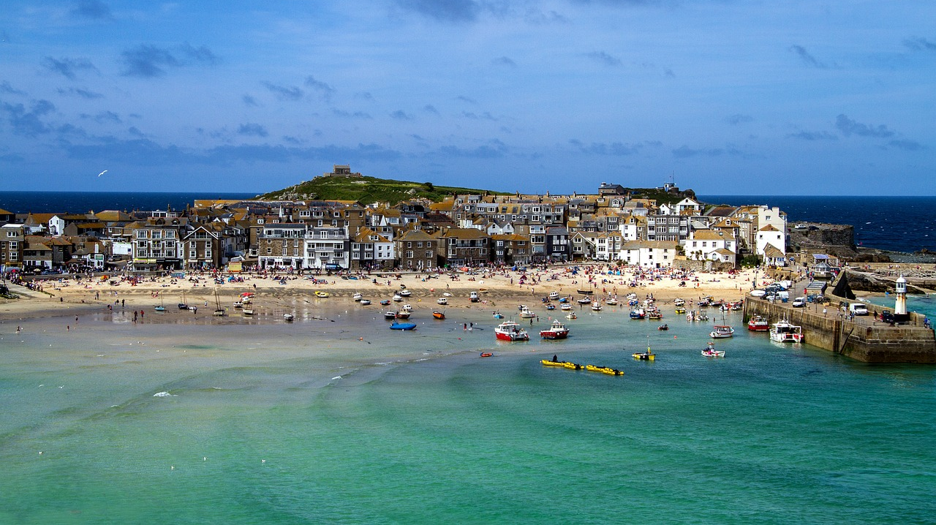
As I was going to St. Ives
I met a man with seven wives,
Each wife had seven sacks,
Each sack had seven cats,
Each cat had seven kits:
Kits, cats, sacks and wives, .….. How many were going to St. Ives?
Notes:
Image from: https://pixabay.com/photos/st-ives-cornwall-england-1816432/

Slide 2
Solution
At least one!
We only know that the narrator is going to St Ives, we don’t know where the others were headed! However, if they were all going to St Ives then……
As I was going to St. Ives
I met a man with seven wives,
Each wife had seven sacks,
Each sack had seven cats,
Each cat had seven kits:
Kits, cats, sacks and wives,
How many were going to St. Ives?
1
1 + 7
7 x 7
(7 x 7) x 7
(7 x 7 x 7) x 7
Total = 2802
Keep clicking to go through all the steps
Notes:
A nice solution for KS5 students using geometric series can be found at: https://mathworld.wolfram.com/StIvesProblem.html

Slide 3
About MEI
Registered charity committed to improving mathematics education
Independent UK curriculum development body
We offer continuing professional development courses, provide specialist tuition for students and work with employers to enhance mathematical skills in the workplace
We also pioneer the development of innovative teaching and learning resources

