Slide 3
Data presentation and interpretation: Diagrams for single variable data Atmosphere – The Hole in the Ozone Layer: Lesson 1
The Big Earth Data Project

Slide 4
Lesson objectives
Be able to interpret diagrams for single-variable data, including boxplots, histograms, frequency polygons and cumulative frequency curves.
Select or critique data presentation techniques in the context of a statistical problem.
Consider the appropriateness of unfamiliar graphs or representations of data.

Slide 5
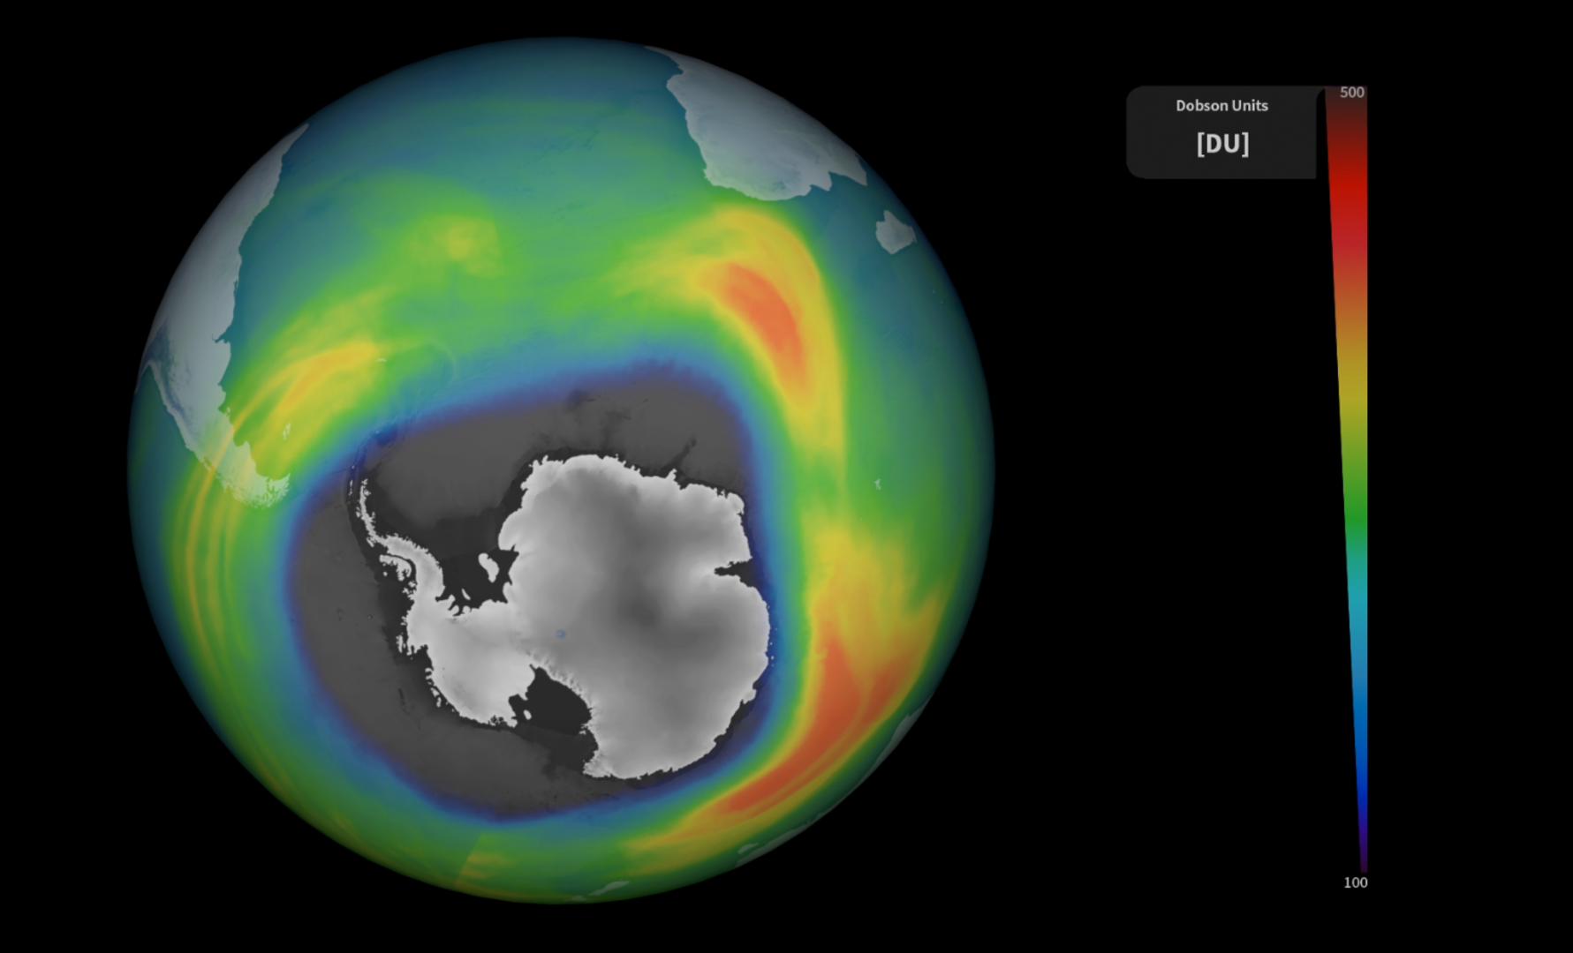
Using diagrams for single variable data
In this lesson you will:
Explore how the hole in the ozone layer varies over the year.
Explore how the hole in the ozone layer varies over the decades.
Notes:
In this lesson students will:
Use different diagrams to explore how the size of the ozone hole varies over different seasons and different decades.
Consider which diagrams are the most and least useful.

Slide 6
Understanding the data

Slide 7
Understanding contexts in statistics
When solving a problem in statistics it is essential that you understand the context that the data comes from.
This is essential for:
Cleaning the data
Choosing statistics and charts
Interpreting the results
Notes:
Introduce the importance of understanding a context when solving a statistical problem. This is essential to:
Clean the data. For example, a value of -1 for temperature in °C is appropriate but -1 for rainfall in mm isn’t.
Choose appropriate statistics (such as averages) and charts to analyse the data.
Interpret the result: i.e. give a meaningful answer to a question.
The following slides explain the context and give some further information.

Slide 8
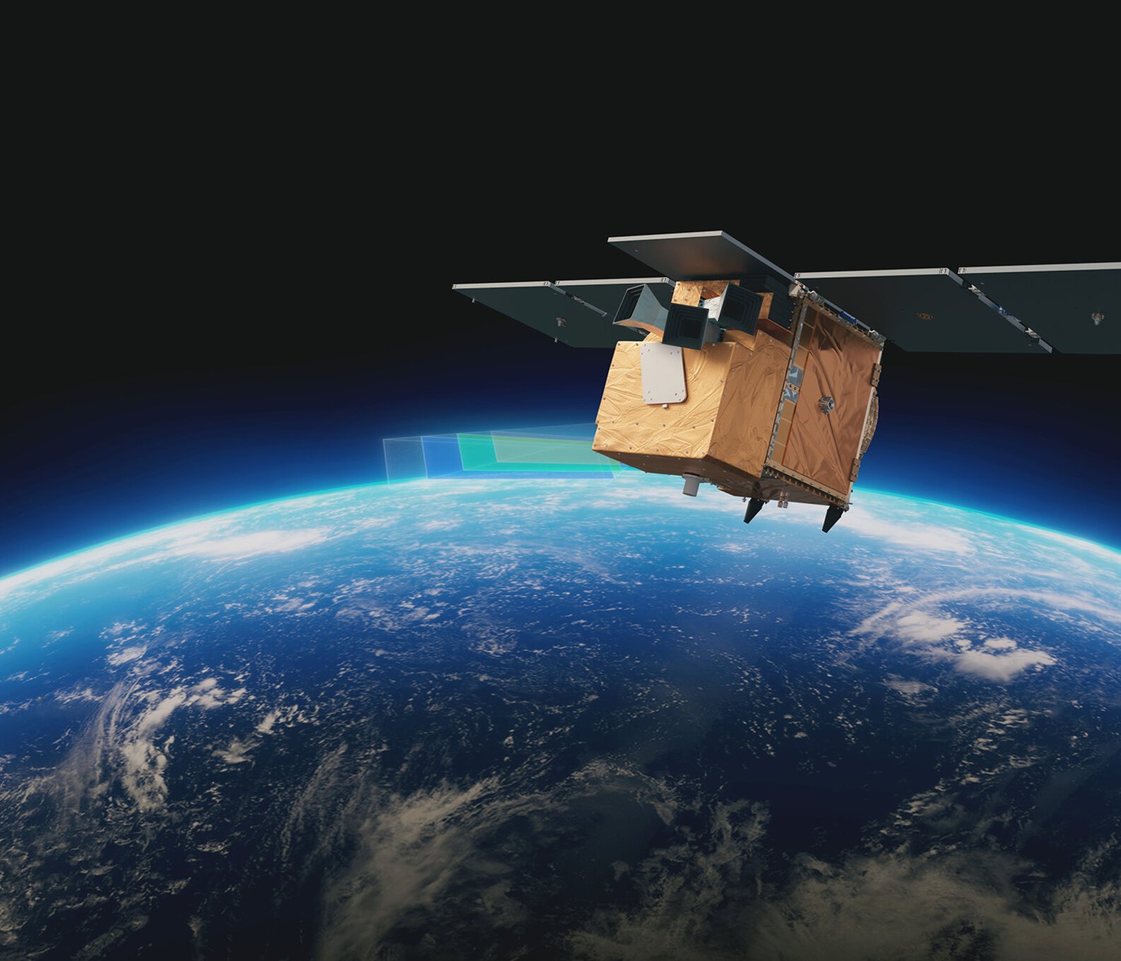
Introduction to the ‘Atmosphere’ activities
In this activity you will explore data about the hole in the ozone layer
The data is from Copernicus: www.copernicus.eu
The data is collected from European Space Agency (ESA)
Notes:
This series of lessons is designed to let you explore features of the ozone layer and the ozone hole using real data.
The data has been collected by scientists working for the European Space Agency (ESA) on a project called Copernicus.
Satellites coordinated by ESA observe the Earth and informs the management of the environment amongst other things.

Slide 9
Ozone and the ozone layer
Ozone is a molecule that is formed naturally in the earth’s atmosphere.
A ‘layer’ of ozone forms about 25km above the Earth’s surface.
This layer protects living organisms from some of the harmful effects of the sun’s radiation.
Notes:
Image: https://www.flickr.com/photos/felton-nyc/50768574522

Slide 10
The Ozone Hole
A hole in the ozone layer above Antarctica was discovered in the 1970s by scientists using satellite data.
This hole was caused by human-made chemicals in the atmosphere.
Since the 1980s, countries have agreed to limit the use of these chemicals.
Notes:
https://commons.wikimedia.org/wiki/File:Ozone_Hole_2015.jpg

Slide 11
The data sets
These activities feature daily and monthly measurements of ozone, atmospheric and weather conditions

Slide 12
The daily data: variables
date
year
month
day
day_of_year
season
decade
ozone_hole_area (million km²)
ozone_column_minimum, (Dobson units)
ozone_mass_deficit, (kg)
air_temperature, (°C), taken at the surface
surface_pressure (hPa)
wind_speed (ms⁻¹), taken at the surface
stratosphere_temperature (°C), taken at an altitude of approximately 25km
Notes:
NB the seasons are defined by southern hemisphere month, not solstices/equinoxes

Slide 13
More information
For more information about the ozone layer and ozone hole see:
Discovering Antarctica: The ozone hole
Our world in data: What is the ozone layer, and why is it important?

Slide 14
Exploring the area of the hole in the ozone layer for different seasons

Slide 15
Task 1
Over the next few slides there are four different representations of the same data.
As you look at them think about:
What feature of the diagram shows that the hole in the ozone layer mostly occurs in the southern hemisphere spring?
Which are the strengths and weaknesses of each diagram?
Notes:
Students will be shown some charts that demonstrate that the hole in the ozone layer mostly occurs in the southern hemisphere spring. They should think about how useful the diagrams are using these questions.

Slide 16
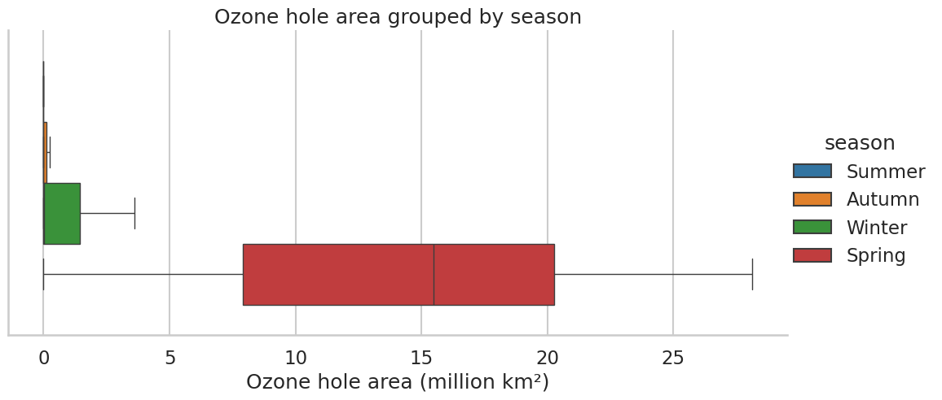
Box Plot
Notes:
The spring data is further to the right and there’s a higher lower quartile, upper quartile and maximum.
It’s easy to compare medians and quartiles.
It only shows five values for the data. You can’t the size of the data set.

Slide 17
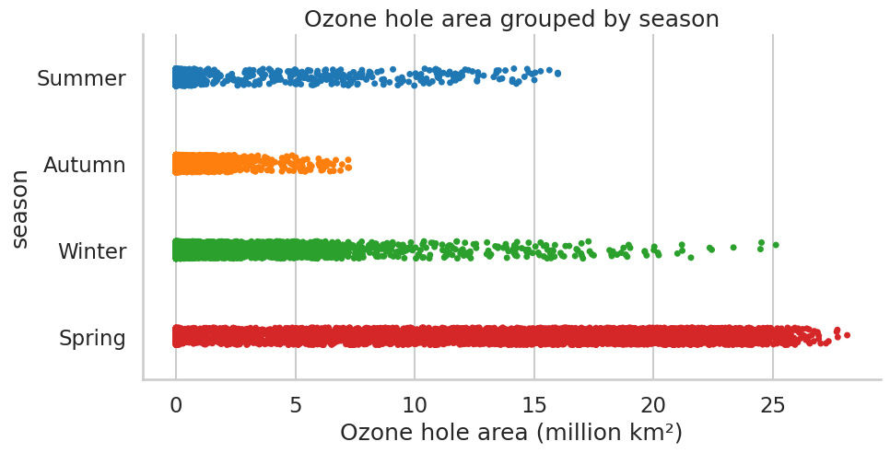
Strip Plot
Notes:
Strip plot: A dot for each point. They are vertically spaced out to make it easier to read but the vertical position has no meaning.
The spring dots are generally further to the right.
It’s easy to see where the majority of the dots are.
For larger data sets (this has 16,071 points split across four categories) it’s difficult to interpret. A small proportion of dots is still a lot of dots!

Slide 18
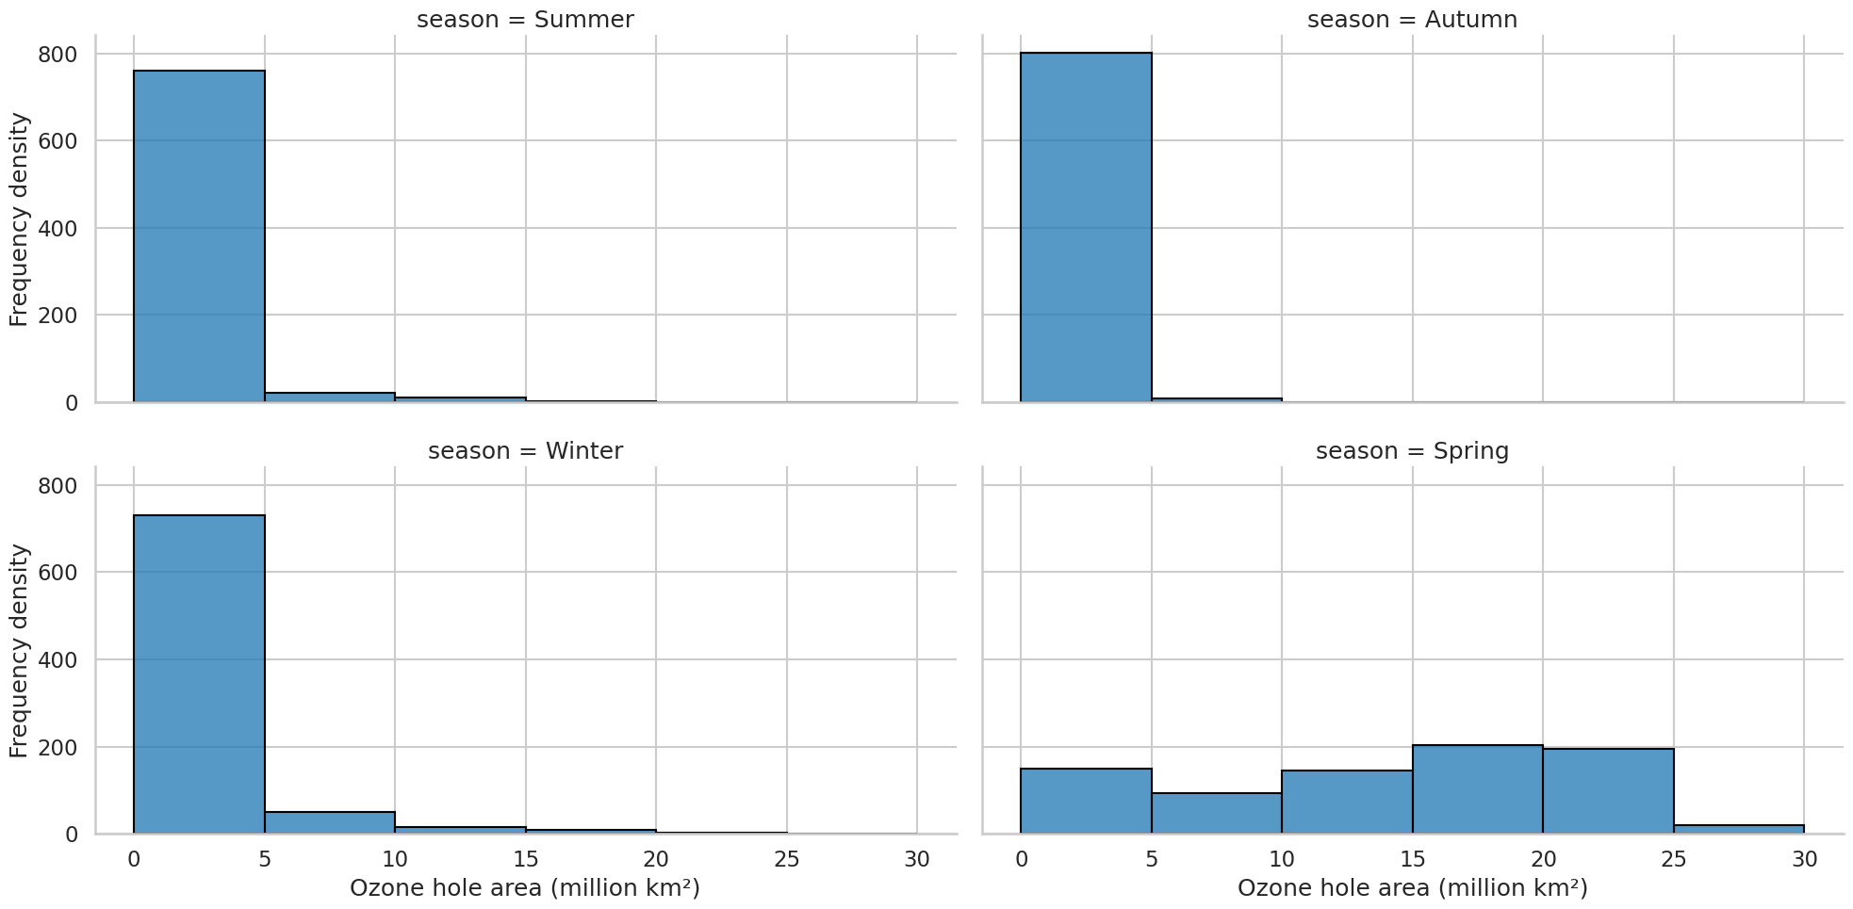
Separate histograms
Notes:
The bars for 5 and above are all higher for spring.
You can use the histogram to compare the amount of data in each group (it’s approximately the same as total area is the same).
You can’t read averages directly from histograms. They can look very different for different interval widths: you can’t tell the other three seasons apart with the minimum interval at 0-5.

Slide 19
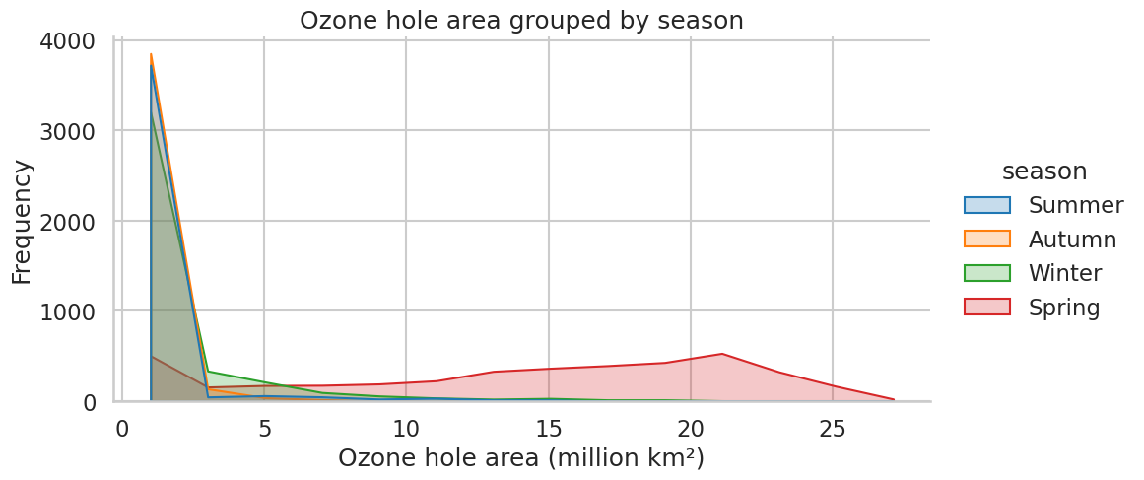
Frequency polygons
Notes:
How are these similar and how are they different to histograms?
What features show that the ozone hole area is mainly observable in the spring?

Slide 20
Comparing visualisations
For these four diagrams:
Box plots
Strip plots
Separate histograms
Frequency polygons
Which did you find the most useful?
Which did you find the least useful?
Notes:
For completeness two further diagrams are given: frequency polygons and cumulative frequency. You can discuss these with students too or skip these and move on to the next section.

Slide 21
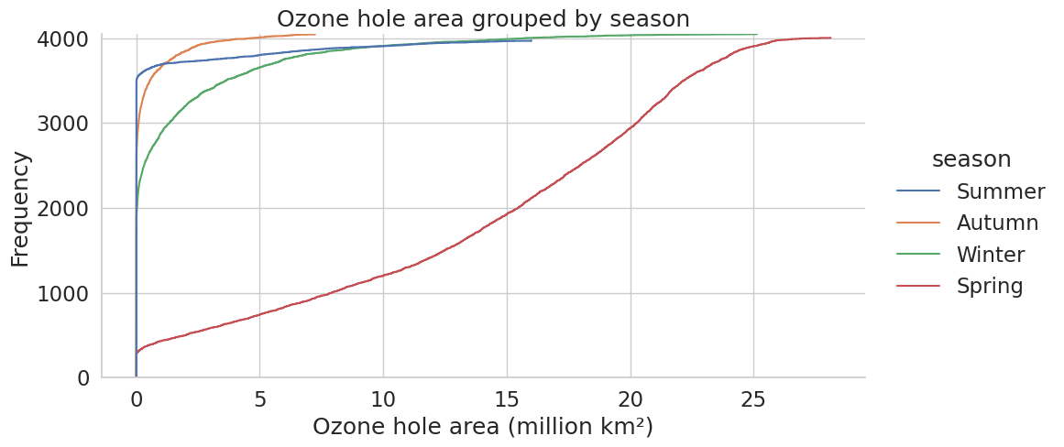
Cumulative frequency
Notes:
Is it obvious that the ozone hole appears in the spring?
Can you see any way in which this diagram might be misleading?

Slide 22
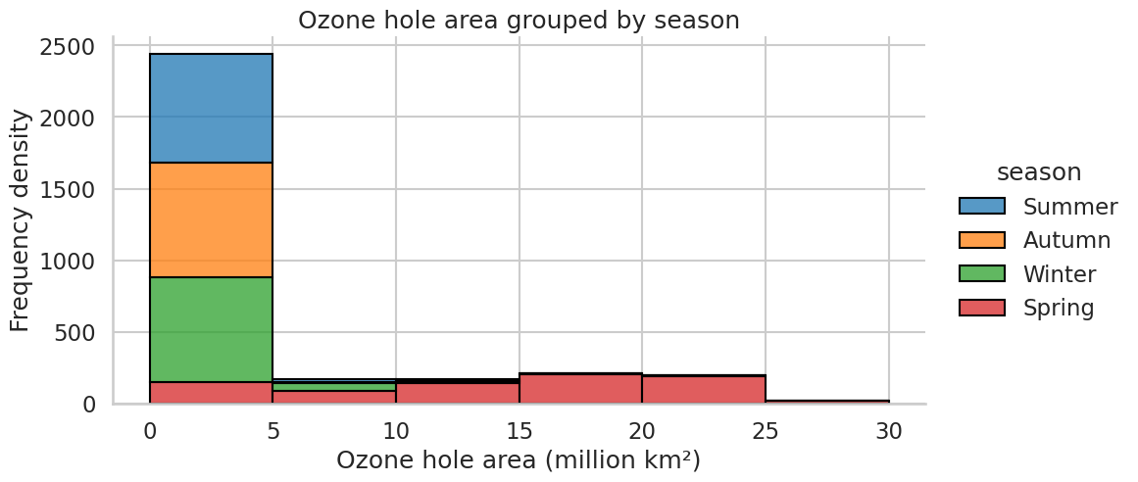
Stacked histograms
Notes:
Is this more useful than plotting the histograms separately?
Can you see any problems representing the data in this way?
What might happen if we changed the bin width? Would you find most of the frequency in 3 of the seasons to be even closer to 0? Does this give the wrong impression of the data?

Slide 23
Exploring the hole in the ozone layer for different decades
Notes:
Discuss how the Southern hemisphere spring is where to focus your attention. The diagrams on the slides show the hole in the ozone layer for spring months (September, October, November), grouped by decade.

Slide 24
Task 2
On the following slides you will see diagrams for the hole in the ozone layer for spring months (Sep, Oct, Nov) grouped by decade.
Discuss the following questions:
What features of the diagrams show a reduction in the size of the hole from 1990 through to 2019?
Scientists believe that the hole is still reducing but that there is not enough data yet from 2020s to confirm this. What features of the diagrams show that there is less data from the 2020s?
Which diagrams do you find the most useful and which diagrams do you find the least useful?

Slide 25
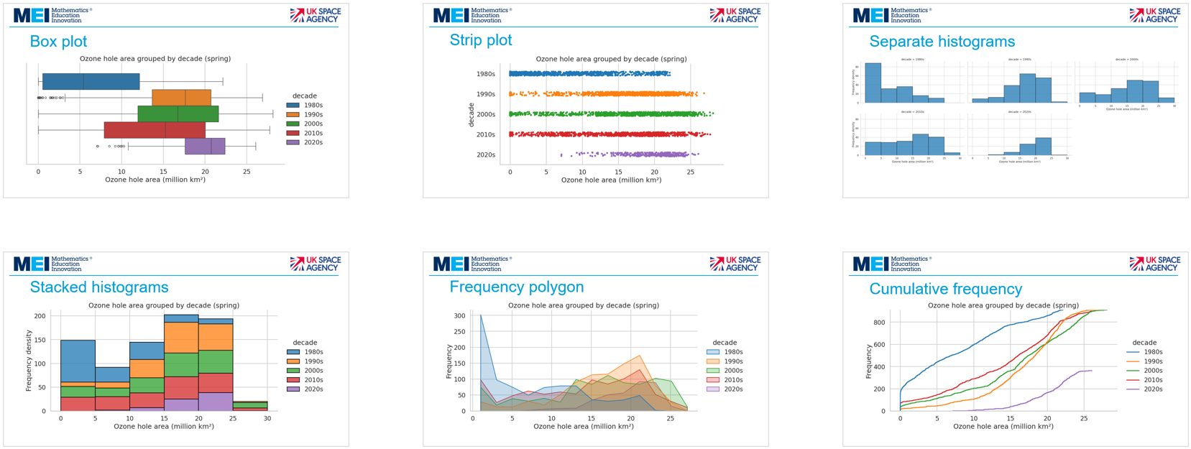
Which diagram would be most useful?
Notes:
Discuss the following questions:
Which of the following diagrams will be the most useful?
What features of the diagrams show a reduction in the size of the hole from 1990 through to 2019?
Scientists believe that the hole is still reducing but that there is not enough data yet from 2020s to confirm this. What features of the diagrams show that there is less data from the 2020s?
Which diagrams do you find the most useful and which diagrams do you find the least useful?

Slide 26
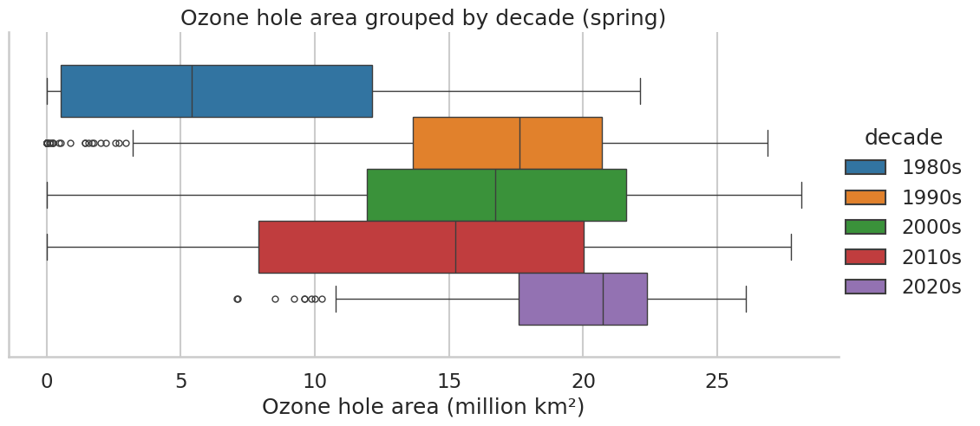
Box plot
Notes:
What does this diagram show about the size of the ozone hole over time?
Why might the data from 2020-2023 be misleading?
What other types of diagram might be useful to view the change in the ozone hole over time?

Slide 27
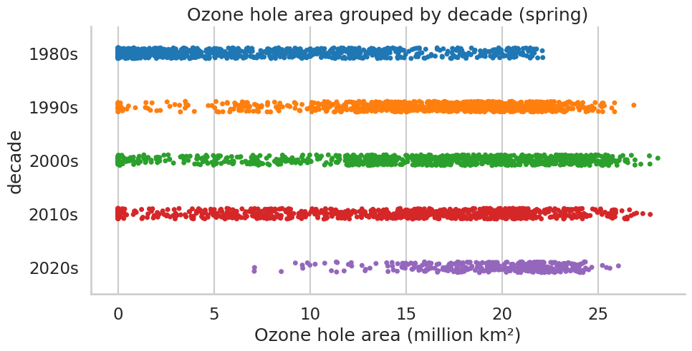
Strip plot

Slide 28
Separate histograms

Slide 29
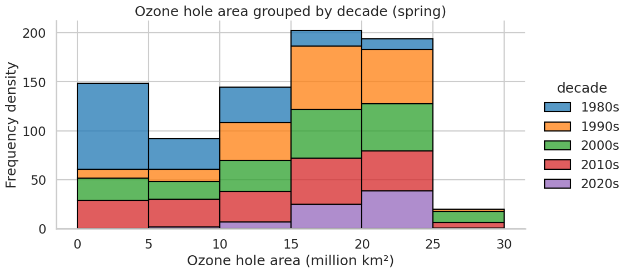
Stacked histograms

Slide 30
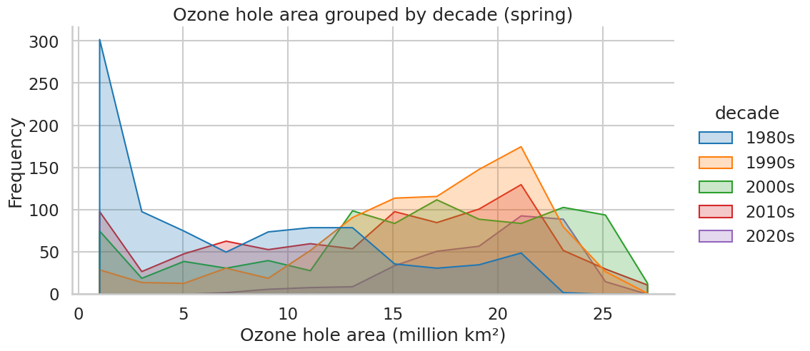
Frequency polygon

Slide 31
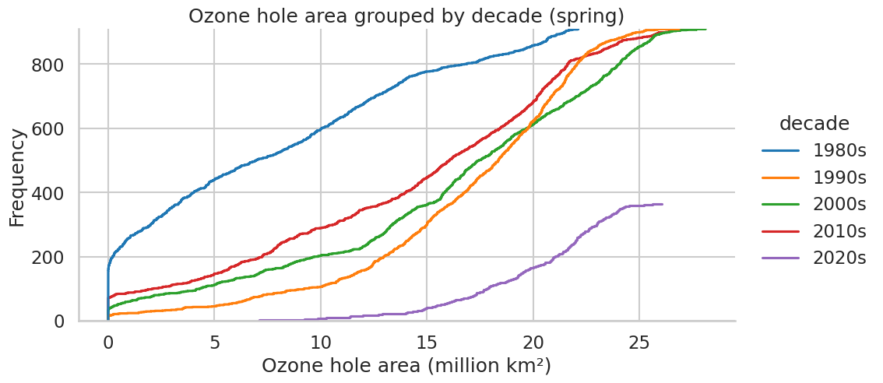
Cumulative frequency

Slide 32
Reflections and extension

Slide 33
Statistical diagrams
What are the strengths and weaknesses of the following diagrams:
Boxplots
Histograms
Frequency polygons
Cumulative frequency curves

Slide 34
Extension task
You can explore other variables and investigate the data more fully using the Python notebook: colab.research.google.com/drive/1tTQ8NbZJimjIiozKWNQj0rCp0ZqemGwO
Questions to investigate:
Explore the other two ozone columns for the different decades. Is it a similar pattern to the ozone hole area?
Explore the minimum temperature for the different decades. Is there a pattern in this?

Slide 35
About MEI
Registered charity committed to improving mathematics education
Independent UK curriculum development body
We offer continuing professional development courses, provide specialist tuition for students and work with employers to enhance mathematical skills in the workplace
We also pioneer the development of innovative teaching and learning resources

