Slide 1
Notes:
https://colab.research.google.com/drive/1hPuY9Yv_Dj3JHKwR4BcVadD6SItECHrs?usp=sharing

Slide 3
Identifying regions in scatter diagrams Atmosphere – The Hole in the Ozone Layer: Lesson 3
The Big Earth Data Project

Slide 4
Lesson objectives
Be able to interpret scatter diagrams for bivariate data.
Be able to recognise distinct sections of a population within a scatter diagram.
Use an informal understanding of correlation.

Slide 5
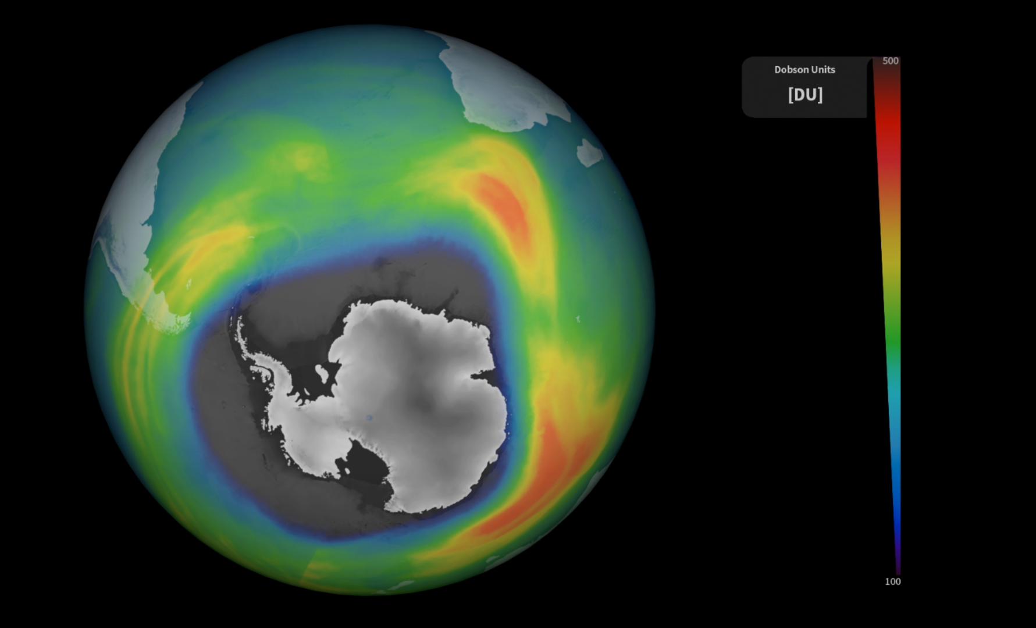
Identifying regions in scatter plots
In this lesson you will:
Observe regions in scatter diagrams.
Explore the correlation in regions of scatter diagrams.
Notes:
In lesson 1 students used Python to explore how the hole in the ozone layer varies over the year. In this lesson they will use different diagrams to explore this and then use these techniques to explore changes over the decades.

Slide 6
Understanding the data
Notes:
If this is the first time using the context then use the opening section to talk to students about:
The importance of using context within statistics.
The ozone layer and the discovery of the ozone hole.
If you have completed lesson with your students you can skip this section or use it to briefly remind them of the context.

Slide 7
Understanding contexts in statistics
When solving a problem in statistics it is essential that you understand the context that the data comes from.
This is essential for:
Cleaning the data
Choosing statistics and charts
Interpreting the results
Notes:
Introduce the importance of understanding a context when solving a statistical problem. This is essential to:
Clean the data. For example, a value of -1 for temperature in °C is appropriate but -1 for rainfall in mm isn’t.
Choose appropriate statistics (such as averages) and charts to analyse the data.
Interpret the result: i.e. give a meaningful answer to a question.

Slide 8
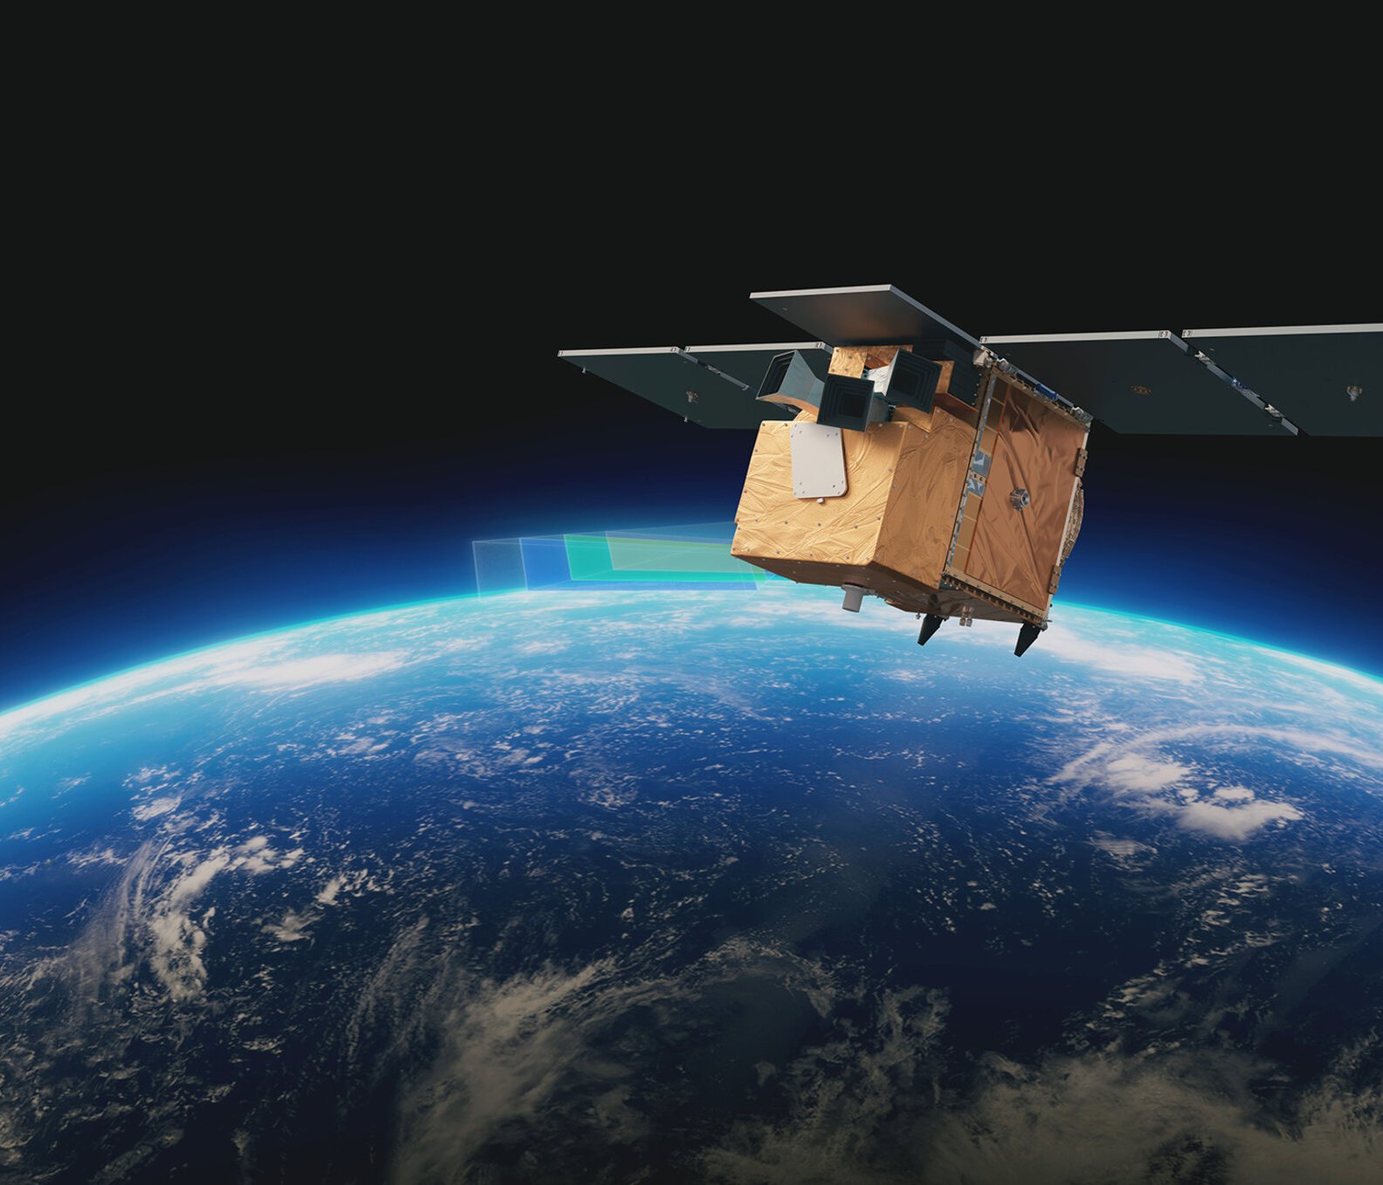
Introduction to the ‘Atmosphere’ activities
In this activity you will explore data about the hole in the ozone layer
The data is from Copernicus: www.copernicus.eu
The data is collected from European Space Agency (ESA)
Notes:
This series of lessons is designed to let you explore features of the ozone layer and the ozone hole using real data.
The data has been collected by scientists working for the European Space Agency (ESA) on a project called Copernicus.
Satellites coordinated by ESA observe the Earth and informs the management of the environment amongst other things.

Slide 9
Ozone and the ozone layer
Ozone is a molecule that is formed naturally in the earth’s atmosphere.
A ‘layer’ of ozone forms about 25km above the Earth’s surface.
This layer protects living organisms from some of the harmful effects of the sun’s radiation.
Notes:
https://www.flickr.com/photos/felton-nyc/50768574522

Slide 10
The Ozone Hole
A hole in the ozone layer above Antarctica was discovered in the 1970s by scientists using satellite data.
This hole was caused by man made chemicals in the atmosphere.
Since the 1980s, countries have agreed to limit the use of these chemicals.
Notes:
https://commons.wikimedia.org/wiki/File:Ozone_Hole_2015.jpg

Slide 11
The data set
These data set for this lesson features monthly measurements of ozone, atmospheric and weather conditions

Slide 12
The monthly data: variables
date
year
month
season
decade
ozone_hole_area (million km²)
ozone_column_minimum, (Dobson units)
ozone_mass_deficit, (kg)
air_temperature, (°C), taken at the surface
surface_pressure (hPa)
wind_speed (ms⁻¹), taken at the surface
stratosphere_temperature (°C), taken at an altitude of approximately 25km
Notes:
NB the seasons are defined by southern hemisphere month, not solstices/equinoxes. Note that for the monthly data the measurements in the right-hand column are the means of the daily values.

Slide 13
More information
For more information about the ozone layer and ozone hole see:
Discovering Antarctica: The ozone hole
Our world in data: What is the ozone layer, and why is it important?

Slide 14
Interpreting scatter diagrams and correlation coefficients

Slide 15
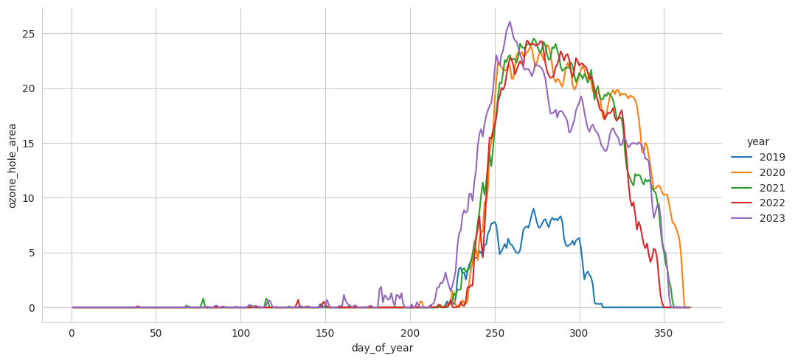
The change in hole area over the year (daily data)
Notes:
The times series for the daily data shows that the hole starts to appear in the second half of the year and is usually closed by the end of the year.

Slide 16
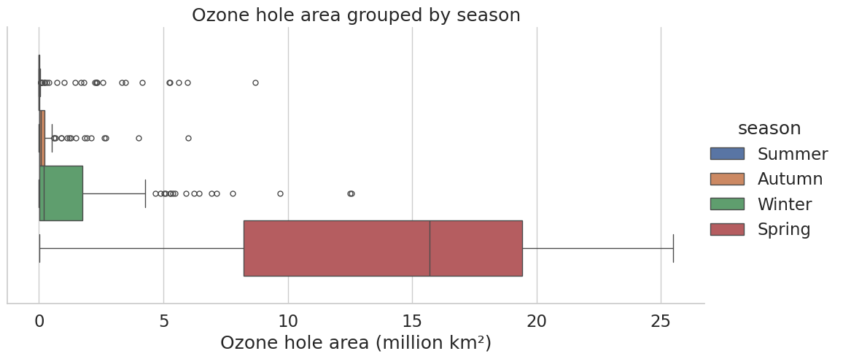
Exploring the seasons

Slide 17
Task 1
The following slides show scatter plots for ozone hole area against air temperature and stratosphere temperature for the spring data.
What type of correlation is shown in each diagram (positive/negative)?
Which show that strongest correlation?
Ozone starts to break down when the temperature is below -78°C and there is sufficient sunlight. Are the scatter diagrams consistent with this?
Notes:
Both show negative but the stratosphere temperature is a stronger correlation. This is expected as the ozone layer is in the stratosphere and air temperature is measured at ground level. The ozone layer breaks down when the temperature is below -78°C; when it’s above this the hole starts to close, but will still be observable when it’s shrinking.

Slide 18
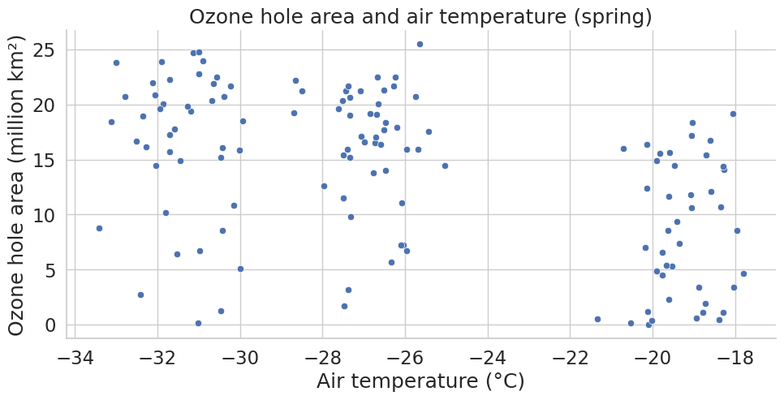
Ozone hole area and air temperature
Correlation coefficient: $$r=−0.477$$
Notes:
Air temperature is measured at ground level.

Slide 19
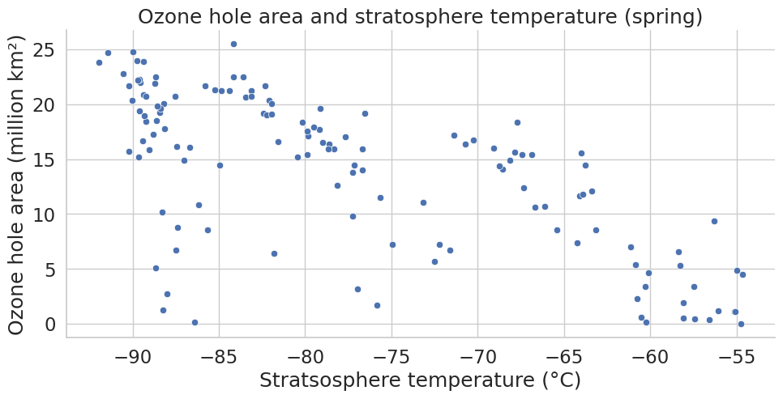
Ozone hole area and stratosphere temperature
Correlation coefficient: $$r=−0.686$$
Notes:
Stratosphere temperature is measured at approximately 25km above ground level.

Slide 20
Finding regions in scatter plots

Slide 21
Task 2
The following slides show scatter plots for ozone hole area against stratosphere temperature for the spring data. The data has been grouped by month and decade.
What patterns are there in the diagrams?
Notes:
For task 2 students have If students have difficulty distinguishing between points there are alternative approaches in the appendix of the notebook.
There is three distinct regions corresponding to different months for the monthly data. This is because the mean daily temperature for each month is different: September is coldest and November is warmest in the southern hemisphere. There aren’t as defined regions for decade; however, the points for the 1980s are at the bottom as this was when the hole in the ozone layer first developed.

Slide 22
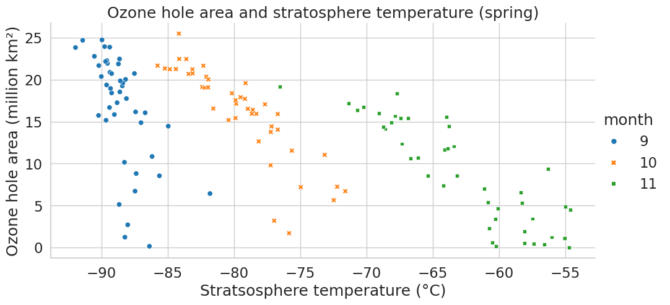
Ozone hole and stratosphere temperature grouped by month
Notes:
There is three distinct regions corresponding to different months for the monthly data. This is because the mean daily temperature for each month is different: September is coldest and November is warmest in the southern hemisphere.

Slide 23
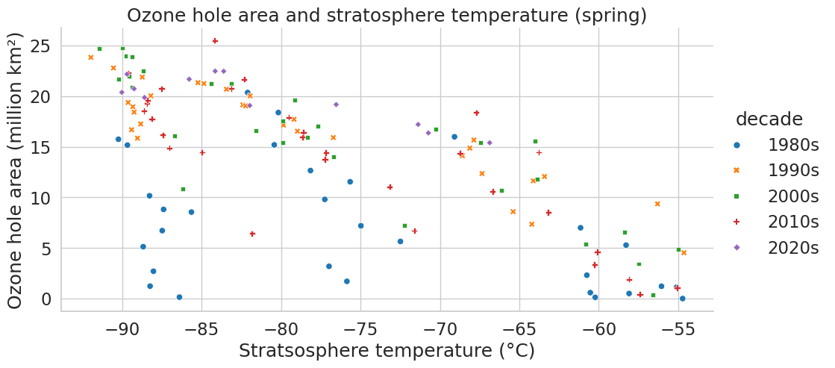
Ozone hole and stratosphere temperature grouped by decade
Notes:
There aren’t as defined regions for decade; however, the points for the 1980s are at the bottom as this was when the hole in the ozone layer first developed.

Slide 24
Exploring the correlation in a region of a scatter plot

Slide 25
Task 3
The following slides show the scatter plots and correlation coefficients for ozone hole area and stratosphere temperature for each of September, October and November.
Which shows the strongest and which show the weakest correlation?
How does this compare to the correlation for the data for the whole of spring?
Notes:
October and November show stronger correlation than the data for the whole of spring. The data for September shows the weakest correlation. Students should be encouraged to look back to the scatter diagram grouped by decade – all the lowest points on the September data are from the 1980s, when the hole was first developing. In the extension task students can explore what the data looks like if the 1980s are removed.

Slide 26
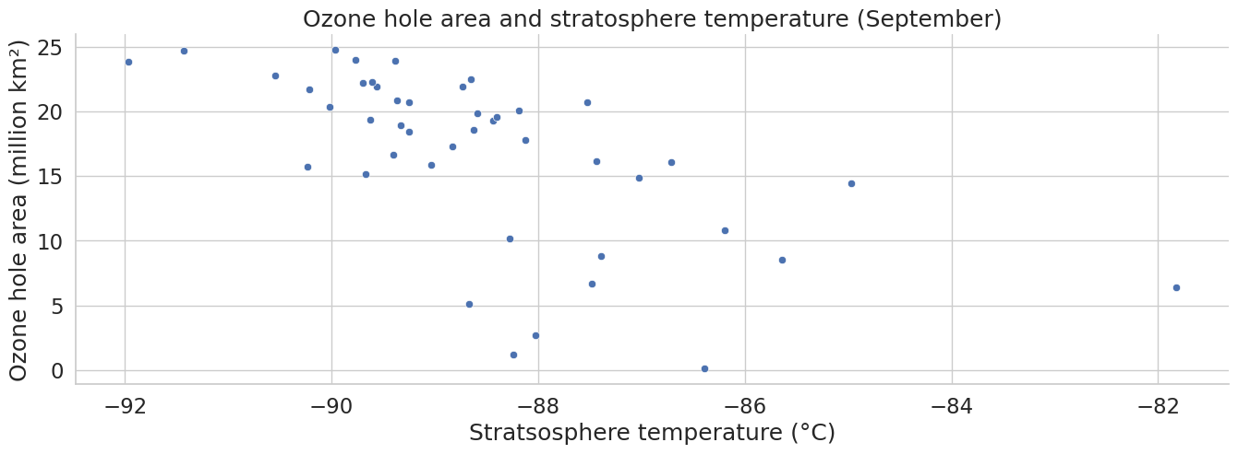
Ozone hole and stratosphere temperature (September)
Correlation coefficient: $r=−0.615$
Notes:
The data for September shows the weakest correlation. Students should be encouraged to look back to the scatter diagram grouped by decade – all the lowest points on the September data are from the 1980s, when the hole was first developing. In the extension task students can explore what the data looks like if the 1980s are removed.

Slide 27
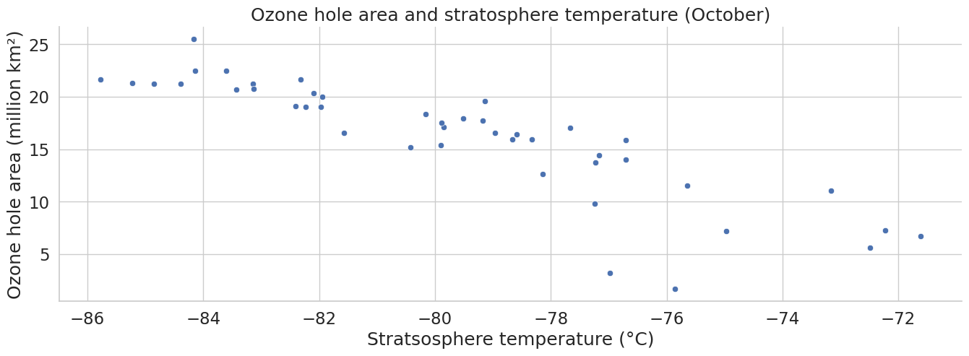
Ozone hole and stratosphere temperature (October)
Correlation coefficient: $r=−0.866$
Notes:
October and November show stronger correlation than the data for the whole of spring. The data for September shows the weakest correlation. Students should be encouraged to look back to the scatter diagram grouped by decade – all the lowest points on the September data are from the 1980s, when the hole was first developing. In the extension task students can explore what the data looks like if the 1980s are removed.

Slide 28
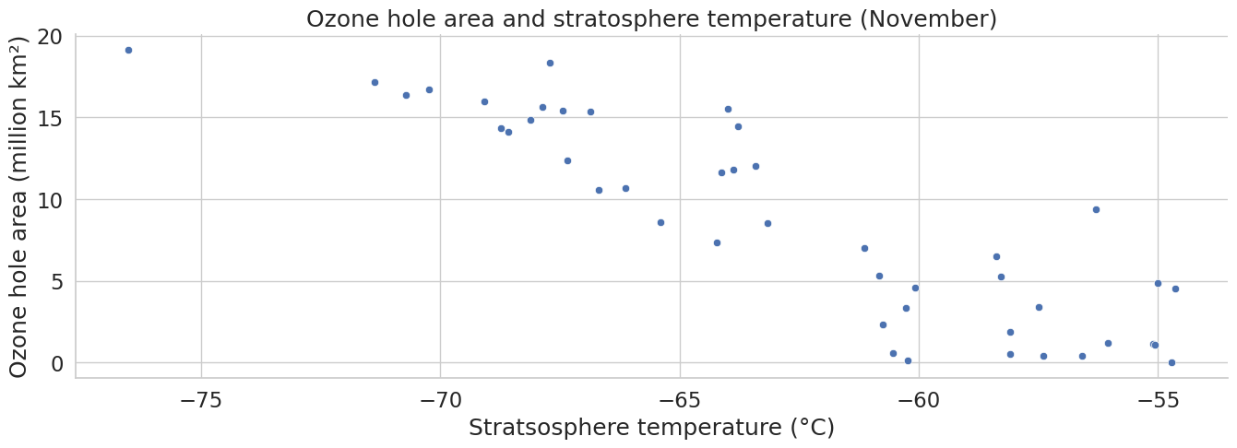
Ozone hole and stratosphere temperature (November)
Correlation coefficient: $r=−0.833$
Notes:
October and November show stronger correlation than the data for the whole of spring. The data for September shows the weakest correlation. Students should be encouraged to look back to the scatter diagram grouped by decade – all the lowest points on the September data are from the 1980s, when the hole was first developing. In the extension task students can explore what the data looks like if the 1980s are removed.

Slide 29
Extension: Identifying regions in the scatter plots for the data since 1990

Slide 30
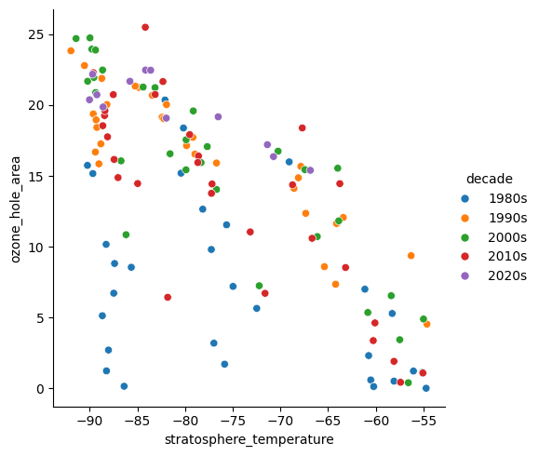
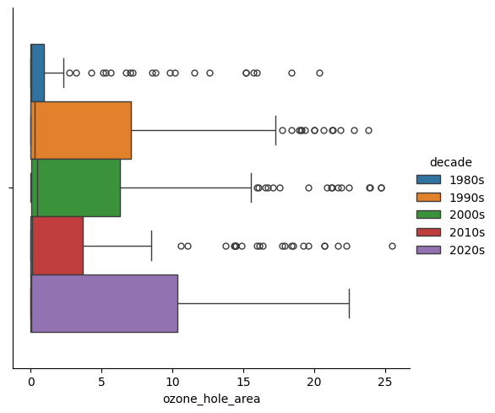
Exploring the ozone hole area over the decades
Notes:
Discuss how the scatter plot and box plot grouped by decade relate to each other. Why does this suggest that it might be useful to concentrate on the data from 1990 onwards?
Demonstrate filtering the data for 1990 onwards and finding some scatter diagrams/correlation coefficients.

Slide 31
Extension task
Filter the spring data for 1990 onwards.
Explore the strength of the correlation between the hole in the ozone layer and stratosphere temperature for different months.
Notes:
More details are given in the notebook.

Slide 32
About MEI
Registered charity committed to improving mathematics education
Independent UK curriculum development body
We offer continuing professional development courses, provide specialist tuition for students and work with employers to enhance mathematical skills in the workplace
We also pioneer the development of innovative teaching and learning resources

