Slide 3
Atmosphere: Introduction to Python Understanding a context to solve a statistical problem Interpreting averages and measures of variation
The Big Earth Data Project

Slide 4
Lesson objectives
Learn how to use Python to explore a big data set.
Explore the importance of understanding a context to solve a statistical problem.
Interpret measures of central tendency and variation.

Slide 5
Understanding the data

Slide 6
Understanding contexts in statistics
When solving a problem in statistics it is essential that you understand the context that the data comes from.
This is essential for:
Cleaning the data
Choosing statistics and charts
Interpreting the results
Notes:
Introduce the importance of understanding a context when solving a statistical problem. This is essential to:
Clean the data. For example, a value of -1 for temperature in °C is appropriate but -1 for rainfall in mm isn’t.
Choose appropriate statistics (such as averages) and charts to analyse the data.
Interpret the result: i.e. give a meaningful answer to a question.
The following slides explain the context and give some further information.

Slide 7
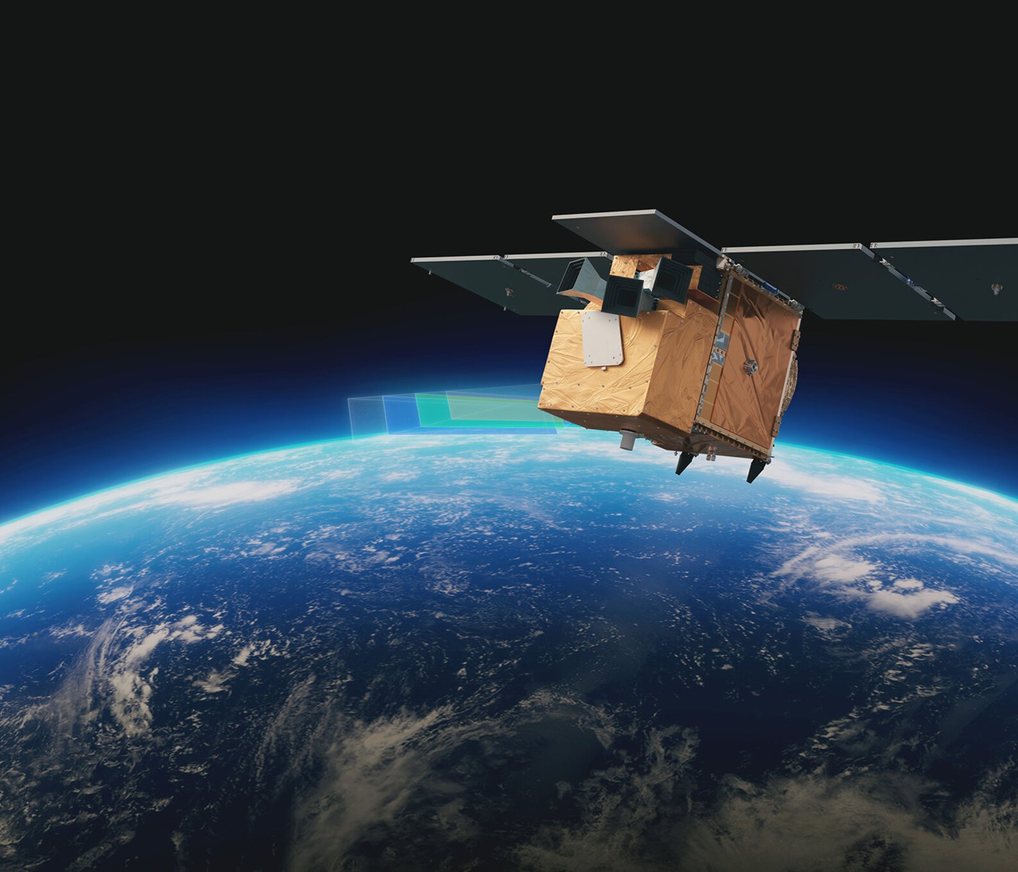
Introduction to the ‘Atmosphere’ activities
In this activity you will explore data about the hole in the ozone layer
The data is from Copernicus: www.copernicus.eu
The data is collected from European Space Agency (ESA)
Notes:
This series of lessons is designed to let you explore features of the ozone layer and the ozone hole using real data.
The data has been collected by scientists working for the European Space Agency (ESA) on a project called Copernicus.
Satellites coordinated by ESA observe the Earth and informs the management of the environment amongst other things.

Slide 8
Ozone and the ozone layer
Ozone is a molecule that is formed naturally in the earth’s atmosphere.
A ‘layer’ of ozone forms about 25km above the Earth’s surface.
This layer protects living organisms from some of the harmful effects of the sun’s radiation.
Notes:
Image: https://www.flickr.com/photos/felton-nyc/50768574522

Slide 9
The Ozone Hole
A hole in the ozone layer above Antarctica was discovered in the 1970s by scientists using satellite data.
This hole was caused by human-made chemicals in the atmosphere.
Since the 1980s, countries have agreed to limit the use of these chemicals.
Notes:
https://commons.wikimedia.org/wiki/File:Ozone_Hole_2015.jpg

Slide 10
The data sets
These activities feature daily and monthly measurements of ozone, atmospheric and weather conditions

Slide 11
The daily data: variables
date
year
month
day
day_of_year
season
decade
ozone_hole_area (million km²)
ozone_column_minimum, (Dobson units)
ozone_mass_deficit, (kg)
air_temperature, (°C), taken at the surface
surface_pressure (hPa)
wind_speed (ms⁻¹), taken at the surface
stratosphere_temperature (°C), taken at an altitude of approximately 25km
Notes:
NB the seasons are defined by southern hemisphere month, not solstices/equinoxes

Slide 12
More information
For more information about the ozone layer and ozone hole see:
Discovering Antarctica: The ozone hole
Our world in data: What is the ozone layer, and why is it important?

Slide 13
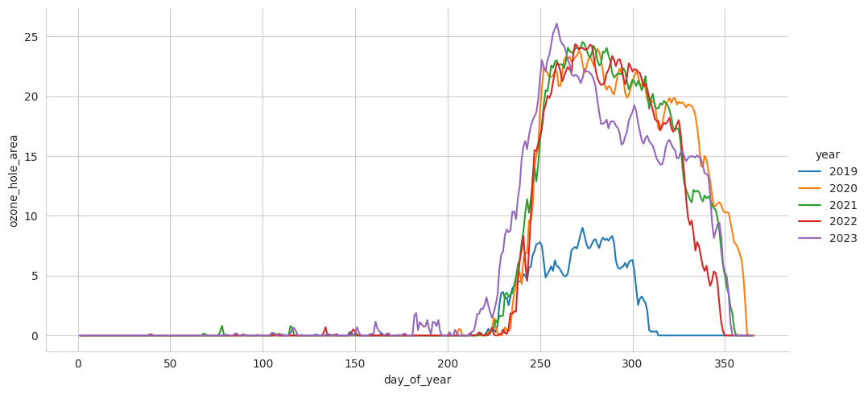
The change in hole area over the year
Notes:
Ask the students:
What do you notice about when the hole has been observable?

Slide 14
Hole in the ozone layer

Slide 15
Size of the ozone hole grouped by season
season | count | mean | std | min | 25% | 50% | 75% | max
Autumn | 4048.0 | 0.31 | 0.87 | 0.0 | 0.00 | 0.00 | 0.10 | 7.24
Spring | 4004.0 | 13.84 | 7.69 | 0.0 | 7.92 | 15.47 | 20.28 | 28.12
Summer | 3971.0 | 0.48 | 1.99 | 0.0 | 0.00 | 0.00 | 0.00 | 16.00
Winter | 4048.0 | 1.49 | 3.20 | 0.0 | 0.00 | 0.03 | 1.45 | 25.14

Slide 16
Size of the ozone hole grouped by season

Slide 17
Task 1a
What season is the hole in the ozone layer mainly visible?
Why is the median a more useful average than the mean for summer, autumn and winter?
Notes:
Students should open the notebook, save it and run all.
They can then try editing a block of code and copying/pasting code into a new block to create grouped statistics and charts for months.
Students use these statistics and charts to answer the Task 1 questions

Slide 18
Size of the ozone hole grouped by month (Jul-Dec)
month | count | mean | std | min | 25% | 50% | 75% | max
7 | 1364.0 | 0.38 | 0.89 | 0.0 | 0.00 | 0.00 | 0.23 | 5.84
8 | 1364.0 | 3.46 | 4.69 | 0.0 | 0.05 | 1.54 | 5.04 | 25.14
9 | 1320.0 | 16.67 | 7.41 | 0.0 | 11.78 | 19.35 | 22.28 | 28.12
10 | 1364.0 | 16.12 | 5.89 | 0.0 | 12.55 | 17.33 | 20.68 | 27.73
11 | 1320.0 | 8.66 | 6.96 | 0.0 | 0.81 | 8.88 | 14.80 | 23.24
12 | 1364.0 | 1.39 | 3.20 | 0.0 | 0.00 | 0.00 | 0.23 | 16.00

Slide 19
Size of the ozone hole grouped by month (Jul-Dec)

Slide 20
Task 1b
Why are September, October and November listed as ‘spring?’
Which months show the biggest variation in the hole in the ozone layer?
Is the standard deviation or the inter-quartile range more useful for this?
Notes:
Students should open the notebook, save it and run all.
They can then try editing a block of code and copying/pasting code into a new block to create grouped statistics and charts for months.
Students use these statistics and charts to answer the Task 1 questions

Slide 21
Interpreting measures of central tendency and variation
Notes:
The purpose of this section is to give students a chance to find different measures of central tendency and variation and to discuss which is the most appropriate or useful.

Slide 22
Ozone depletion
Clouds occur in the stratosphere when the temperature is below –78°C.
Between August and March there is sufficient sunlight for the pollutants react with the clouds to break down ozone.
These conditions only usually occur over the South Pole.
Notes:
Note that these are the most common conditions for the breakdown of Ozone, there are many other factors too.

Slide 23
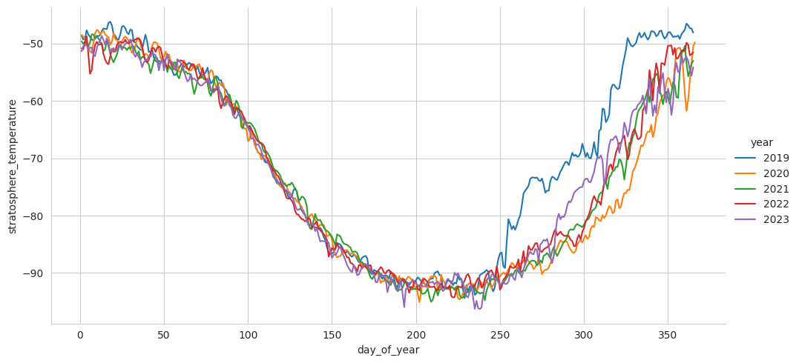
The change in stratosphere temperature over the year
Notes:
This chart shows when the temperature is below -78°C. There is sufficient sunlight from August (1st August is day 213 or 214 of the year).
Students should consider this diagram when creating their box plots in task 2. With these conditions in mind, they’re going to explore the stratospheric temperature by season and by month and think about when the ozone hole is created.
The code to create this is in the appendix of the notebook.

Slide 24
Task 2
Find the statistics and charts for stratosphere temperature grouped by season and month.
Discuss the following questions:
How does the temperature in the stratosphere vary over the year?
Did you find the grouping by season or the grouping by month easier to interpret?
Which average is more appropriate: mean, median or either?
Which measure of variation is more appropriate: standard deviation, inter-quartile range or either?

Slide 25
Extension task
Explore how some of the other numerical variables vary over the year.

Slide 26
About MEI
Registered charity committed to improving mathematics education
Independent UK curriculum development body
We offer continuing professional development courses, provide specialist tuition for students and work with employers to enhance mathematical skills in the workplace
We also pioneer the development of innovative teaching and learning resources

