Slide 2
Atmosphere: Lesson 1 Diagrams, averages and measures of spread
The Big Earth Data Project

Slide 3
Lesson objectives
Be able to interpret diagrams for single-variable data, including boxplots and (single width) histograms.
Calculate averages and measures of spread.
Discuss reasons for selecting certain representations or averages.

Slide 4
Understanding a context to solve a statistical problem

Slide 5
Understanding contexts in statistics
When solving a problem in statistics it is essential that you understand the context that the data comes from.
This is essential for:
Cleaning the data
Choosing statistics and charts
Interpreting the results
Notes:
Introduce the importance of understanding a context when solving a statistical problem. This is essential to:
Clean the data. For example, a value of -1 for temperature in °C is appropriate but -1 for rainfall in mm isn’t.
Choose appropriate statistics (such as averages) and charts to analyse the data.
Interpret the result: i.e. give a meaningful answer to a question.

Slide 6
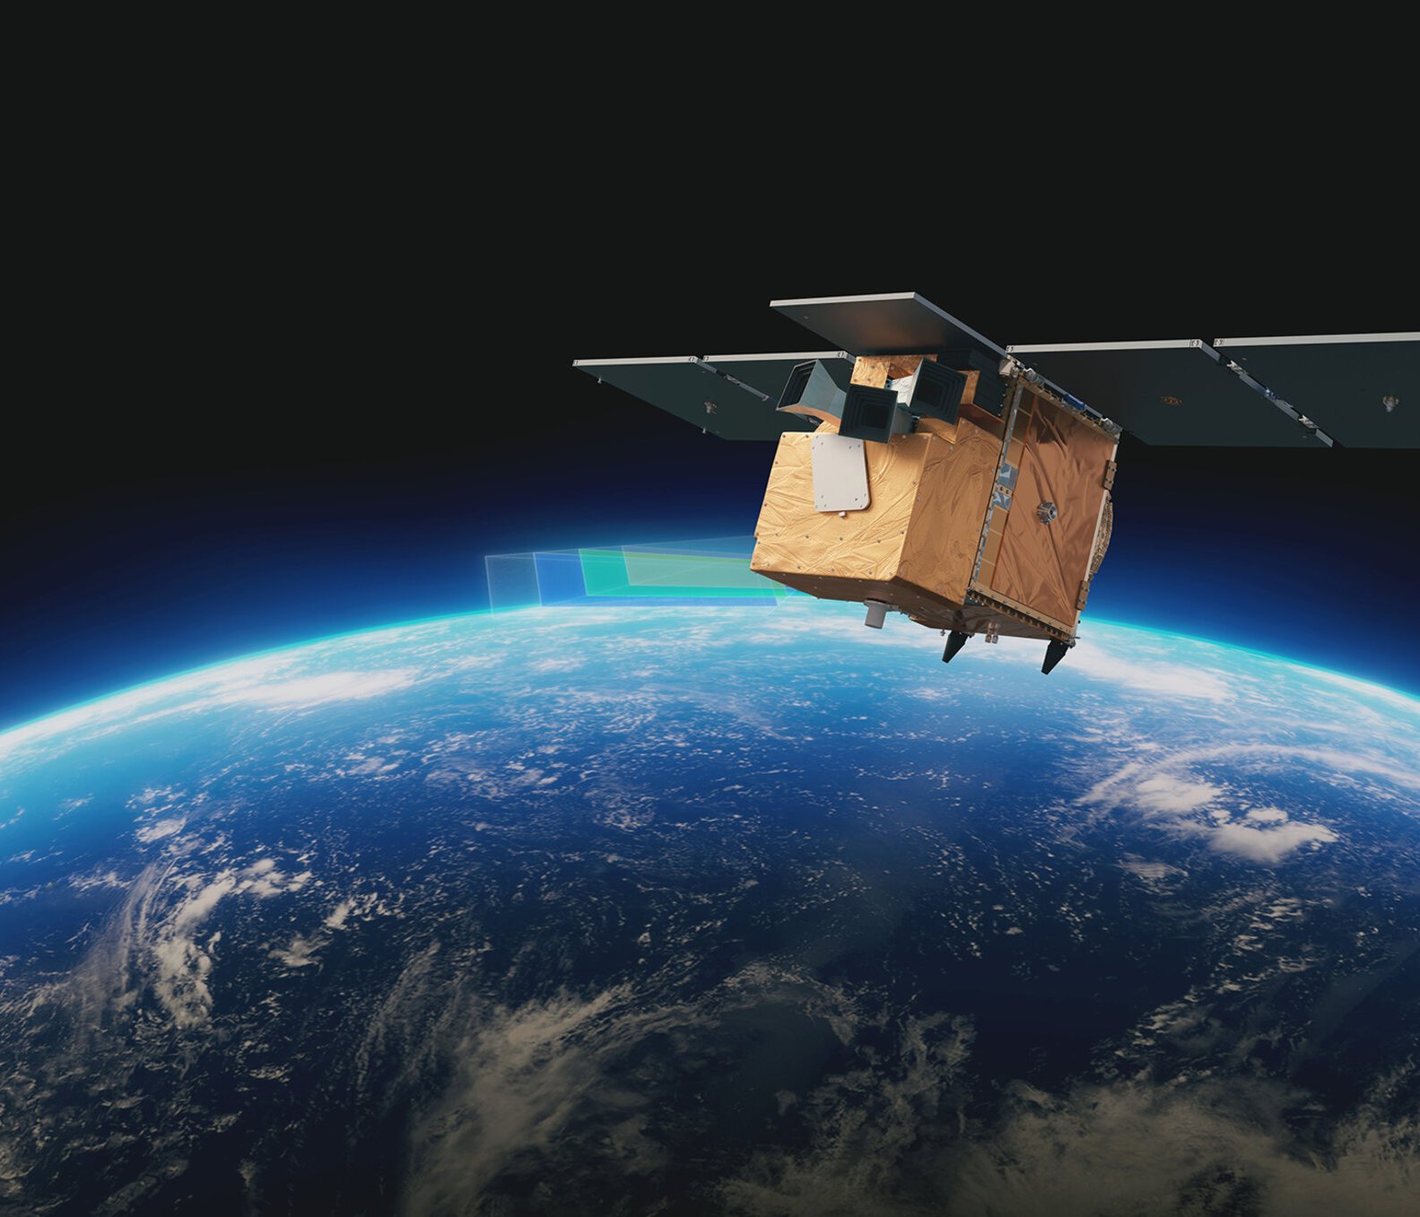
Introduction to the ‘Atmosphere’ activities
In this activity you will explore data about the hole in the ozone layer
The data is from Copernicus: www.copernicus.eu
The data is collected from European Space Agency (ESA)
Notes:
This series of lessons is designed to let you explore features of the ozone layer and the ozone hole using real data.
The data has been collected by scientists working for the European Space Agency (ESA) on a project called Copernicus.
Satellites coordinated by ESA observe the Earth and informs the management of the environment amongst other things.

Slide 7
Ozone and the ozone layer
Ozone is a molecule that is formed naturally in the earth’s atmosphere.
A ‘layer’ of ozone forms about 25km above the Earth’s surface.
This layer protects living organisms from some of the harmful effects of the sun’s radiation.
Notes:
https://www.flickr.com/photos/felton-nyc/50768574522

Slide 8
The Ozone Hole
A hole in the ozone layer above Antarctica was discovered in the 1970s by scientists using satellite data.
This hole was caused by man made chemicals in the atmosphere.
Since the 1980s, countries have agreed to limit the use of these chemicals.
Notes:
https://commons.wikimedia.org/wiki/File:Ozone_Hole_2015.jpg

Slide 9
More information
For more information about the ozone layer and ozone hole see
https://discoveringantarctica.org.uk/oceans-atmosphere-landscape/atmosphere-weather-and-climate/the-ozone-hole/
What is the ozone layer, and why is it important? - Our World in Data

Slide 10
Averages and measures of spread

Slide 11
Data Exploration
Often the easiest way to understand a data set is to draw some diagrams
This allows us to spot patterns and look for meaning in the data

Slide 12
The change in hole area over the year
Each of the dots on the graph represents the size of the ozone hole in a particular month.
In which season are the largest areas?
How easy is it to tell the differences between the seasons?
What other graphs and calculations would give us some more information?

Slide 13
Averages
Averages help us compare different sets of data, and get a “best guess” data point.
Different types of averages are best in different situations.
What are the names of the averages you know?
Notes:
You might want to discuss why you wouldn’t use mode for the average height, or why we talk about median wage rather than mean.
Often students will mention the range as an average so you may want to discuss the difference between averages and measures of spread

Slide 14
Measuring the middle
In each of the diagrams, the red line represents the median value and the blue line is the mean.
Why is the median lower than the mean for 3 of the seasons?
Which average is better to use?
Would the mode be useful in this situation? Why/Why not?

Slide 15
Measures of spread
Measures of spread tell us how consistent or variable a set of data is.
Different types of calculation are used in different situations
What are the names of measures of spread that you know?

Slide 16
Visualising the spread of data
The graph now shows box plots for each of the seasons
What are the 5 pieces of information that a box plot shows?
Which of the seasons has the most variation in ozone hole area?
Which has the least?

Slide 17
Visualising the spread of data
Why does Summer appear to have no box?
Which measure of spread do you think would be most useful to use to compare the seasons?

Slide 18
Frequency diagrams and bar charts

Slide 19
The ‘shape’ of the data
Even calculating the averages and measures of spread sometimes doesn’t give us enough information about the data
We can show the shape of the data by drawing a histogram or bar chart

Slide 20
Frequency diagrams
The diagram shows how many months there were with ozone holes of different sizes
Is it clearer than the box plot?
Which is the most common ozone hole area in Spring?
Is the number of months with 0 to 2 million square kilometres ozone hole area larger than you thought from the box plot?

Slide 21
What other questions can we ask of the data?

Slide 22
What other questions can we ask of the data?
Some suggestions
What does the distribution of the ozone hole look like for the other seasons?
Has the ozone hole got larger or smaller on average each decade?
Which month has the largest ozone hole area?
What about the other features in the data? How does the temperature or windspeed vary?
To find out more and use the data yourself follow the link below
https://codap.concord.org/app/static/dg/en/cert/index.html#shared=https%3A%2F%2Fcfm-shared.concord.org%2FzqpkyjmhE6tf7nfu2Apr%2Ffile.json

Slide 23
Demonstrations for exploring data
Creating the graphs in this presentation
Creating frequency diagrams for other seasons
Creating box plots for different decades

Slide 24
Summary
Box plots can be used to compare both the average of data sets as well as the spread of the data
Box plots show 5 pieces of information
Averages are used to tell you how big or small the middle of the data is.
There are 3 averages commonly used
Measures of spread tell you how inconsistent or spread out a set of data is.
There are 2 measures of spread commonly used
Frequency diagrams let us compare distributions of data by showing us their shape.

Slide 25
About MEI
Registered charity committed to improving mathematics education
Independent UK curriculum development body
We offer continuing professional development courses, provide specialist tuition for students and work with employers to enhance mathematical skills in the workplace
We also pioneer the development of innovative teaching and learning resources

