Slide 3
Atmosphere: Lesson 2 Diagrams, averages and measures of spread for single variable data
The Big Earth Data Project

Slide 4
Lesson Objectives
Draw line graphs to show variation over time.
Use averages and other statistics to draw conclusions about yearly variation.
Use context to interpret graphs and statistics.

Slide 5
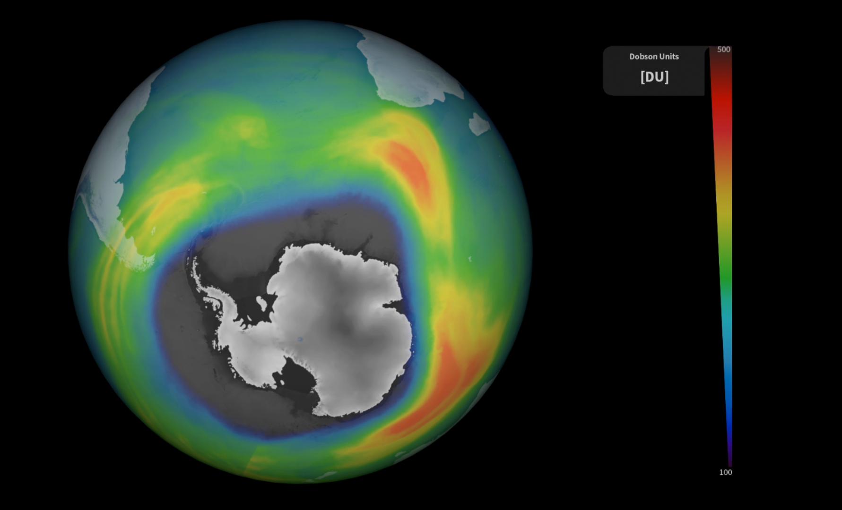
Using diagrams for time series
In this lesson you will:
Learn how to create a graph in CODAP.
Learn how to compare different data sets in CODAP.
Learn how to calculate statistics in CODAP.
Explore how the hole in the ozone layer varies over the year.

Slide 6
Understanding a context to solve a statistical problem

Slide 7
Understanding contexts in statistics
When solving a problem in statistics it is essential that you understand the context that the data comes from.
This is essential for:
Cleaning the data
Choosing statistics and charts
Interpreting the results
Notes:
Introduce the importance of understanding a context when solving a statistical problem. This is essential to:
Clean the data. For example, a value of -1 for temperature in °C is appropriate but -1 for rainfall in mm isn’t.
Choose appropriate statistics (such as averages) and charts to analyse the data.
Interpret the result: i.e. give a meaningful answer to a question.

Slide 8
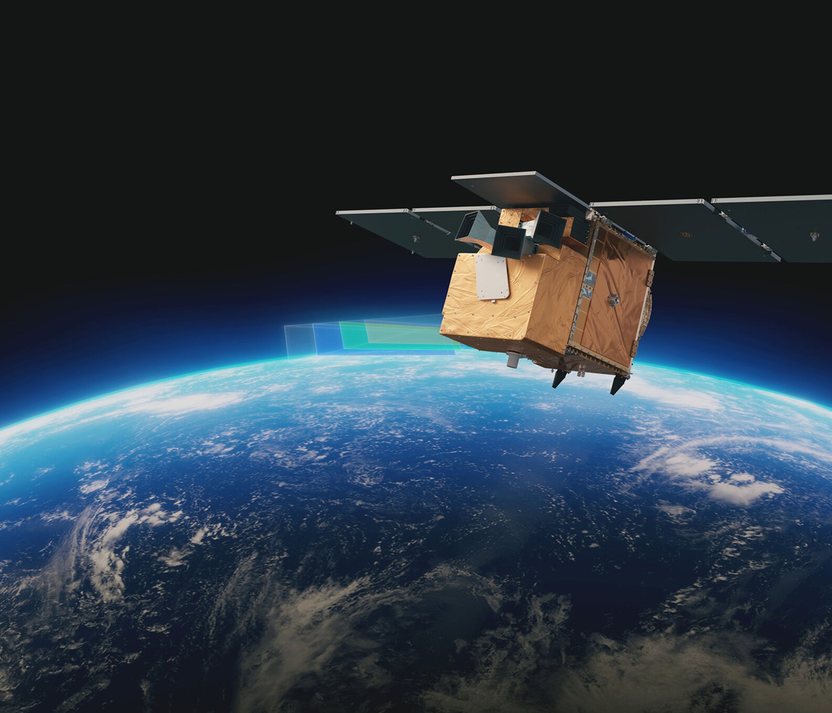
Introduction to the ‘Atmosphere’ activities
In this activity you will explore data about the hole in the ozone layer
The data is from Copernicus: www.copernicus.eu
The data is collected from European Space Agency (ESA)
Notes:
This series of lessons is designed to let you explore features of the ozone layer and the ozone hole using real data.
The data has been collected by scientists working for the European Space Agency (ESA) on a project called Copernicus.
Satellites coordinated by ESA observe the Earth and informs the management of the environment amongst other things.

Slide 9
Ozone and the ozone layer
Ozone is a molecule that is formed naturally in the earth’s atmosphere.
A ‘layer’ of ozone forms about 25km above the Earth’s surface.
This layer protects living organisms from some of the harmful effects of the sun’s radiation.
Notes:
https://www.flickr.com/photos/felton-nyc/50768574522

Slide 10
The Ozone Hole
A hole in the ozone layer above Antarctica was discovered in the 1970s by scientists using satellite data.
This hole was caused by man made chemicals in the atmosphere.
Since the 1980s, countries have agreed to limit the use of these chemicals.
Notes:
https://commons.wikimedia.org/wiki/File:Ozone_Hole_2015.jpg

Slide 11
More information
For more information about the ozone layer and ozone hole see
https://discoveringantarctica.org.uk/oceans-atmosphere-landscape/atmosphere-weather-and-climate/the-ozone-hole/
What is the ozone layer, and why is it important? - Our World in Data

Slide 12
Time series

Slide 13
Time series
A time series is a graph where time is on the x axis and the feature you want to track is on the y axis.
Time series are useful for
Seeing whether a feature increases or decreases over time
Observing any repeating patterns that may occur

Slide 14
Weekly Data
The data used in this presentation is a single reading of the ozone hole area and other measurements each week from January 1980 until December 2023.
The questions we attempt to answer are
How does the ozone hole area change over time?
Will there be any repeating patterns in the size of the ozone hole?
Do other measurements in the data repeat in the same way as the ozone hole?

Slide 15
Ozone hole area for the whole period
What can we tell about how the ozone hole has changed over time?
Which year has the maximum value?
What could we do to make this graph better?
Notes:
Ozone hole areas are smaller before 1990.
There are times in the year when the area of the hole is 0 and others where it quite large.
Largest value looks like it could be 2000 or 2001,
Students might discuss - Zooming in on to a few years - Taking averages - Adding colour

Slide 16
Taking statistics
We will now take the mean of each year.
Why the mean and not the median?
What other statistics on the ozone hole size might be useful to calculate?

Slide 17
Average ozone hole area for each year
Is this a more useful graph than the time series for individual days? Are the trends more obvious?
What are the similarities in the trend of the two graphs?
What are the differences?

Slide 18
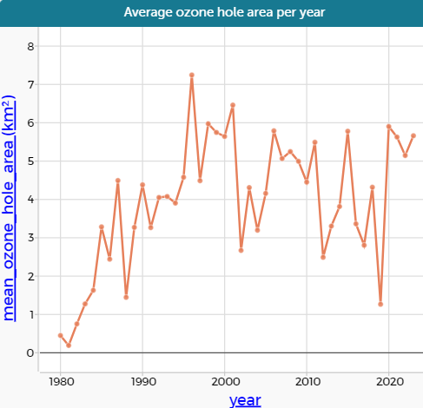
A comparison of the two graphs

Slide 19
Comparing maximum and mean
The graph shows both the maximum and the mean ozone hole area for each month
Can you describe the differences or similarities in shape?
Why might the maximum ozone hole area be more useful than the mean?

Slide 20
Seasonal variation

Slide 21
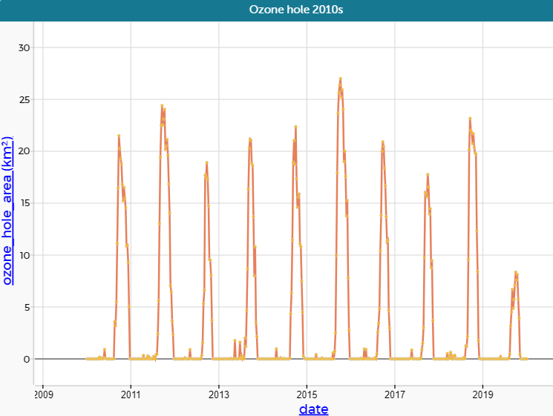
Repeating patterns
The repeating pattern in the ozone hole area is fairly consistent each year.
This is easier to see if we overlay the years on top of each other

Slide 22
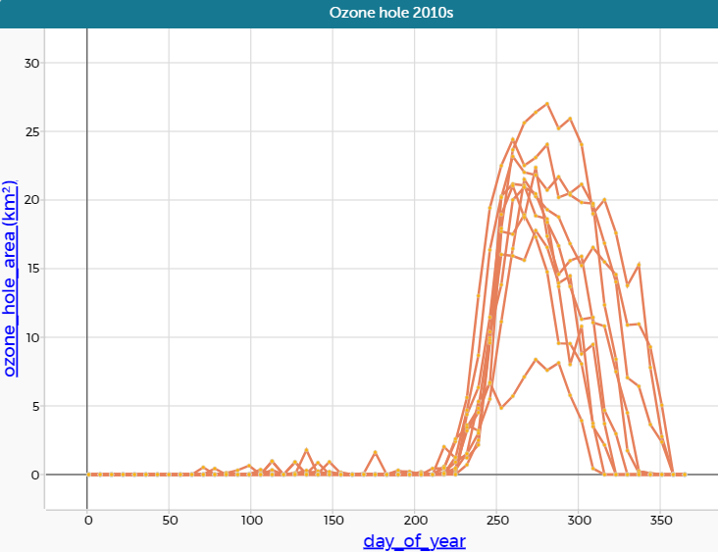
Overlaying the years
What do you notice about the seasonal variation of the ozone hole area?
When does the ozone hole usually start to open? When does it close?
Do you notice anything different about each of the years?

Slide 23
How the ozone hole forms
CFCs in the atmosphere break down the ozone layer when there is UV radiation and when there are stratospheric clouds
Clouds only form in the stratosphere when the temperature falls below a certain level.
Use the information above to explain why the ozone hole is only observable after day 200 in the year.
What time series might you draw in order to show this?

Slide 24
Investigating relationships
Some of the other measurements in the data set are
Air temperature
Surface pressure
Wind speed
Stratospheric temperature
It’s possible to plot these on the same set of axes to observe how they interact
Think about what you expect the series to look like before you plot it.

Slide 25
Demonstrations for exploring data
Interactive data for this lesson
Video creating the graphs in this presentation
Video showing time series for other features
Video showing multiple time series on same axes

Slide 26
Summary
Time series are used to show trends or patterns within data
Repeated patterns are often referred to as seasonal variation.
The choice of time interval and overall time period make a difference in how easy it is to spot trends in the data

Slide 27
About MEI
Registered charity committed to improving mathematics education
Independent UK curriculum development body
We offer continuing professional development courses, provide specialist tuition for students and work with employers to enhance mathematical skills in the workplace
We also pioneer the development of innovative teaching and learning resources

