Slide 3
Atmosphere: Lesson 3 Scatter diagrams, correlation, association and lines of best fit
The Big Earth Data Project

Slide 4
Lesson objectives
Be able to interpret associations between two variables using a scatter graph
Be able to use a line of best fit to make predictions
Understand when predictions are likely to be reliable

Slide 5
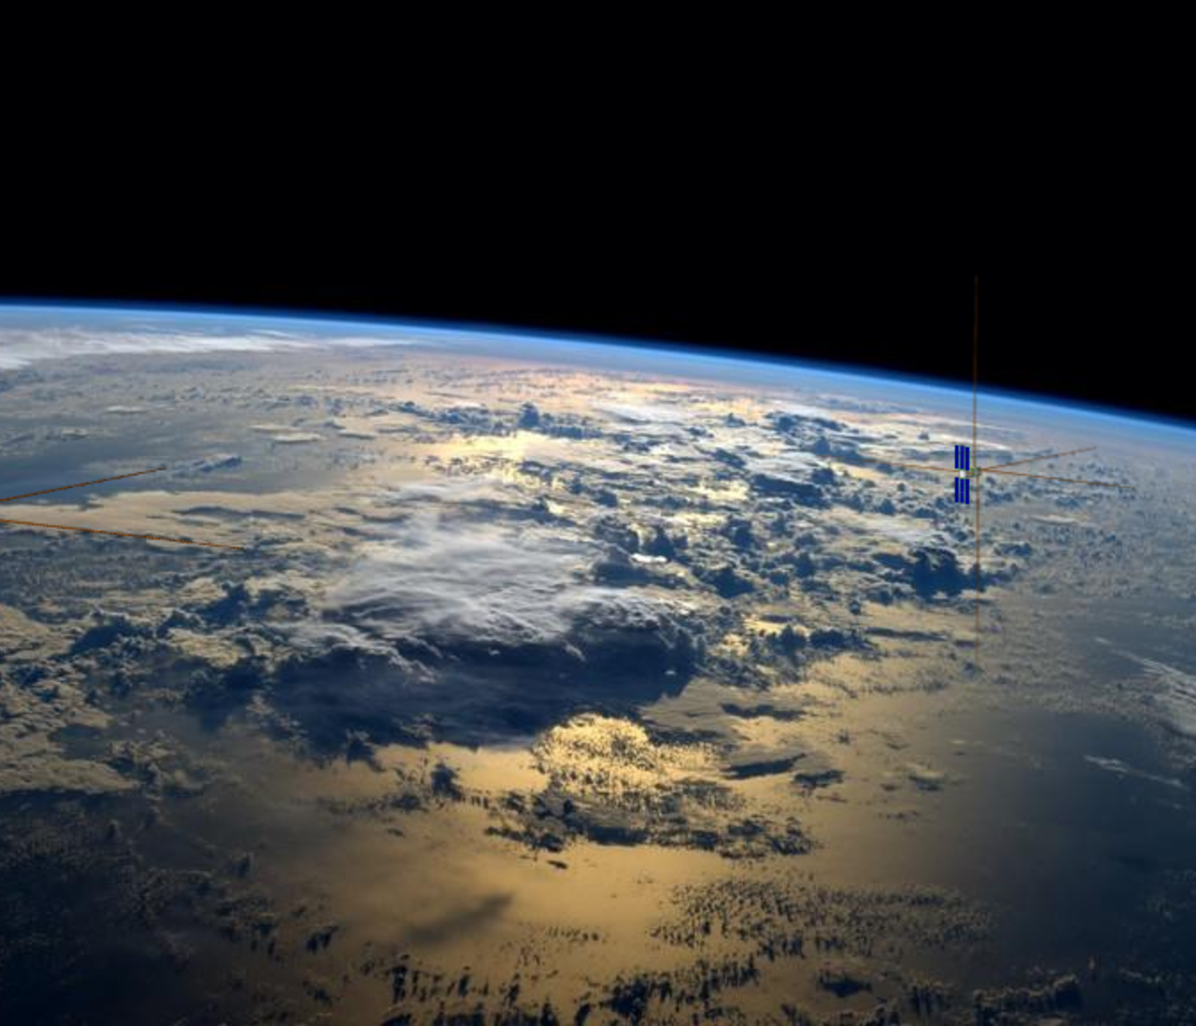
Using scatter graphs to investigate association
In this lesson you will
Learn about different types of association
Explore different associations of atmospheric data relating to the ozone hole.
Notes:
Image: https://www.esa.int/var/esa/storage/images/esa_multimedia/images/2024/04/curie_rendition_in_flight/26009033-1-eng-GB/CURIE_rendition_in_flight_pillars.png

Slide 6
Understanding a context to solve a statistical problem

Slide 7
Understanding contexts in statistics
When solving a problem in statistics it is essential that you understand the context that the data comes from.
This is essential for:
Cleaning the data
Choosing statistics and charts
Interpreting the results
Notes:
Introduce the importance of understanding a context when solving a statistical problem. This is essential to:
Clean the data. For example, a value of -1 for temperature in °C is appropriate but -1 for rainfall in mm isn’t.
Choose appropriate statistics (such as averages) and charts to analyse the data.
Interpret the result: i.e. give a meaningful answer to a question.

Slide 8
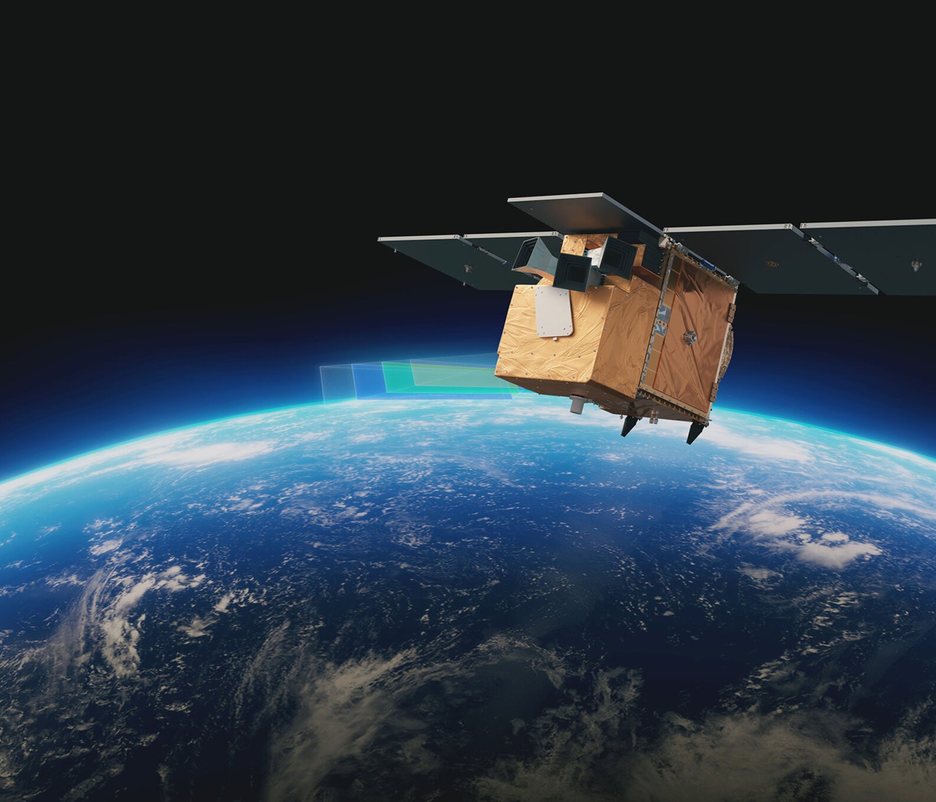
Introduction to the ‘Atmosphere’ activities
In this activity you will explore data about the hole in the ozone layer
The data is from Copernicus: www.copernicus.eu
The data is collected from European Space Agency (ESA)
Notes:
This series of lessons is designed to let you explore features of the ozone layer and the ozone hole using real data.
The data has been collected by scientists working for the European Space Agency (ESA) on a project called Copernicus.
Satellites coordinated by ESA observe the Earth and informs the management of the environment amongst other things.

Slide 9
Ozone and the ozone layer
Ozone is a molecule that is formed naturally in the earth’s atmosphere.
A ‘layer’ of ozone forms about 25km above the Earth’s surface.
This layer protects living organisms from some of the harmful effects of the sun’s radiation.
Notes:
https://www.flickr.com/photos/felton-nyc/50768574522

Slide 10
The Ozone Hole
A hole in the ozone layer above Antarctica was discovered in the 1970s by scientists using satellite data.
This hole was caused by man made chemicals in the atmosphere.
Since the 1980s, countries have agreed to limit the use of these chemicals.
Notes:
https://commons.wikimedia.org/wiki/File:Ozone_Hole_2015.jpg

Slide 11
More information
For more information about the ozone layer and ozone hole see
https://discoveringantarctica.org.uk/oceans-atmosphere-landscape/atmosphere-weather-and-climate/the-ozone-hole/
What is the ozone layer, and why is it important? - Our World in Data

Slide 12
Exploring relationships using scatter graphs
Notes:
Image: https://www.esa.int/var/esa/storage/images/esa_multimedia/images/2024/03/arctic_weather_satellite/25999011-1-eng-GB/Arctic_Weather_Satellite_pillars.jpg

Slide 13
Scatter graphs
Scatter graphs are used to show the relationship between two numerical variables.
We can also use scatter graphs to identify a pattern in the data and use this to make predictions and estimations.

Slide 14
Monthly data
The data used in this presentation is a single value for ozone hole area and other data for each month from January 1980 to December 2023.
The questions we will attempt to answer are
What other measurements are associated with the size of ozone hole area?
Can we make a reliable estimate of the ozone hole area using other measures in the data
Are there any relationships between any of the other measures in the data

Slide 15
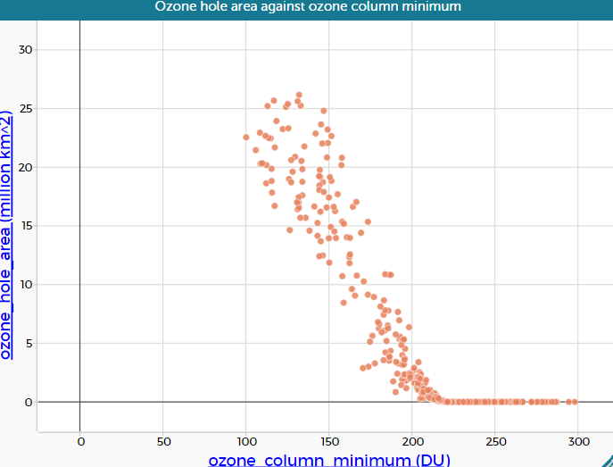
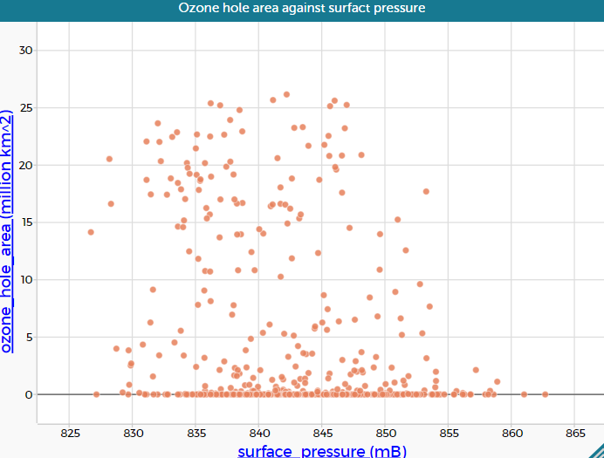
Associations and correlations
Which of the following scatter graphs show there is probably relationship between the two measures?

Slide 16
Describe the relationship
How would you describe the relationship between ozone hole area and ozone column minimum?
What happens to the ozone hole area as the ozone column minimum increases?
Does the whole graph follow the same pattern?

Slide 17
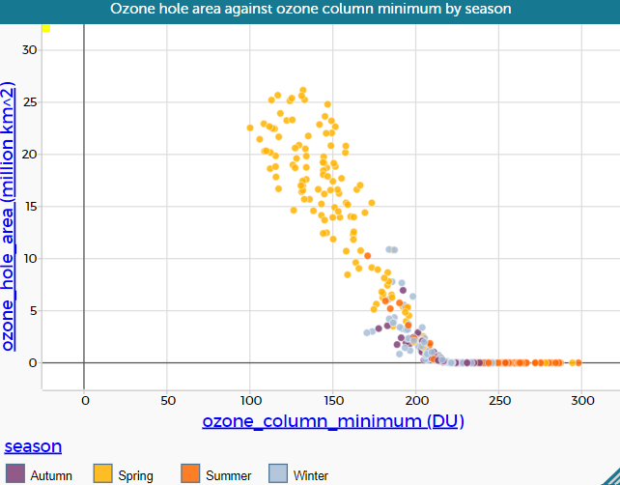
Describe the relationship
The graph has now had another feature added by colouring the points by which season the readings are taken.
Do all the seasons have the same trend?
How would you describe them differently?

Slide 18
Lines of best fit

Slide 19
Line of best fit
A line of best fit is a model for the data which allows estimates to be made for one measurement when you know the other one.
Lines of best fit follow as closely to the majority of the data as they can in order to show the trend.
These lines do not have to be straight (but most of the ones you will see in maths lessons will be)

Slide 20
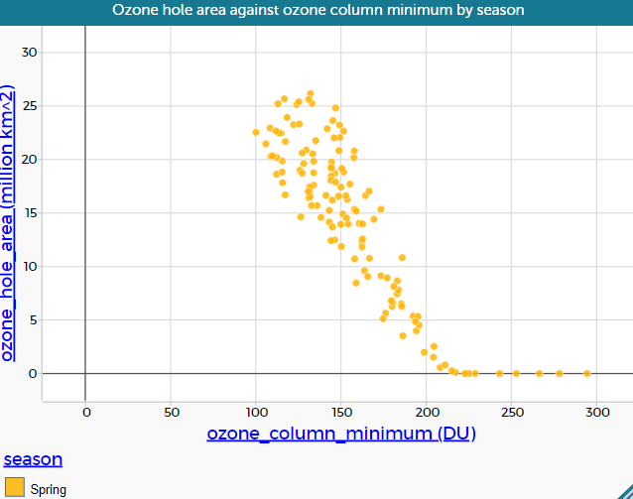
Where do we draw the line?
These points are for Spring data only
Can you draw a straight line through the majority of the data?
Is there an area of the data which doesn’t follow the pattern of your straight line?

Slide 21
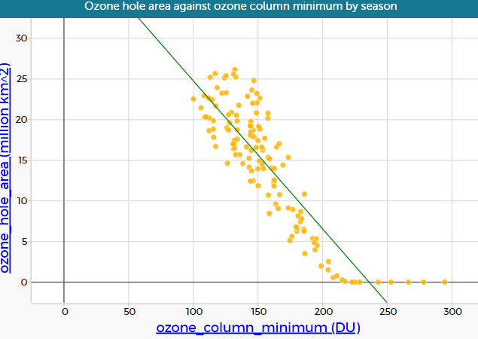
Least squares line
Software will often be able to calculate a straight line for the data.
The method used for this graph is called ‘least squares’
Is the line different to the one drawn by eye?
Which is the better model for the majority of the data?

Slide 22
The equation of the line of best fit
The equation of the least squares line calculated by the software is
$$y=−0.182 x+43$$
Where
$x$ is the ozone column minimum (in Dobson units)
$y$ is the size of the ozone hole (in million km²)
How might you calculate the equation of your line?

Slide 23
Using the equation of the line of best fit
Example
What is the size of the ozone hole you would expect for a day when the ozone column minimum is 150DU?
$$y=−0.182 x+43$$
Where
$x$ is the ozone column minimum (in Dobson units)
$y$ is the size of the ozone hole (in million km²)

Slide 24
Solution
$$y=−0.182 x+43$$
Find $y$ when $x$ is 150
$$y=−0.182\left(150\right)+43 \\ y=15.7$$
Ozone hole area 15.7 million km²

Slide 25
Questions to do
Find the expected ozone hole area for the following ozone column minimums using $y=−0.182 x+43$
100DU
200DU
250DU
Think about your answers, do they all make sense?
Look again at the picture of the line of best fit on the scatter graph. Will the line work for all values of the ozone column minimum?

Slide 26
Answers
$y=−0.182 x+43$
24.8 million km²
6.6 million km²
-2.5 million km²
These are areas so negatives shouldn’t be possible.
The line on the diagram goes below the x axis but the trend cannot continue into the negatives

Slide 27
Summary
Scatter graphs show the relationship between two numerical variables
Not all relationships are linear.
A line of best fit can be used to make estimations for one of the variables
We need to think about whether the line of best fit is suitable for estimations in all parts of the data set.

Slide 28
Demonstrations for exploring data
Creating the graphs in this presentation
Creating graphs of other variables
Which other features of the data might be related?
Where you find a relationship, is it linear?
Will the trends continue for values beyond the end of the graph?

Slide 29
About MEI
Registered charity committed to improving mathematics education
Independent UK curriculum development body
We offer continuing professional development courses, provide specialist tuition for students and work with employers to enhance mathematical skills in the workplace
We also pioneer the development of innovative teaching and learning resources

